Slide 1
Day1 Single cell RNA-seq
NIEHS Workshop--Analyzing NGS data
https://github.com/zhuy16/NIEHS_NGS_Workshop
July 13, 2021
9am-2pm
Yunhua Zhu, PhD
zzhonghua@gmail.com
Computational Genomics Specialist, Transcriptomics
Medical Science & Computing

Slide 2
Instructor’s background
Bachelor @ National University of Singapore(NUS) in Biochemistry 2000-03
Ph.D @ NUS in stem cell biology | 2006 -10
Postdoc @ Hopkins with wet lab & dry lab | 2014 - 2019
Neurogenesis w/t single-cell RNA-seq
Neurodegeneration w/t single-nucleus RNA-seq
Learning R, Bash script statistics through Google and Youtube
Computational Genomics Specialist @ BCBB | 2019
Single-cell RNA-seq, CITE-seq
SMARTseq2 pipeline with FASTQC, RSEM, SENIC
10X genomics pipeline with Cellranger, Seurat, Scanpy and RNA Velocity.
Bulk RNA-seq
Deconvolution Bulk RNA-seq using ABIS and CybersortX.
Functional annotation with clusterProfiler.
Epigenetics
ATAC-seq and Chip-seq

Slide 3
Aims of the workshop
Target audience: NIEHS researchers who want to learn NGS data analysis.
Aims: to provide an overview of NGS analysis workflow for scRNA-seq, bulk RNA-seq and ChIP-seq.
Prerequisite: comfortable with shell scripts, R and python codes.
We will use biowulf HPC as the computation environment, and use Jupyter lab as an interface
The github repository is for illustration only. Data files are included in Biowulf folders for use in the class.
The README.md contains information to set up the workplace.
This is 2-day (4hr each day) workshop on NGS data analysis.
On the 1st day, we will focus on single cell RNA-seq. I will start from NGS_Workshop_Day1.pdf from the resources folder, do a ~30mins presentation.
This will help setting up the working environment and get background knowledge on single-cell RNA-seq.
The presentation will be followed by practical exercises in the scRNA-seq/notebooks folder.
On the 2nd day, we will discuss Bulk RNA-seq and ChIP-seq. I will start from the NGS_Workshop_Day2.pdf file to do a presentation, which will be followed by exercises in the bulk-RNA and ChIP-seq folder.
We will use jupyter lab interface on Biowulf (an NIH HPC system), Please refer to Getting_started.md to setup the working environment.

Slide 4
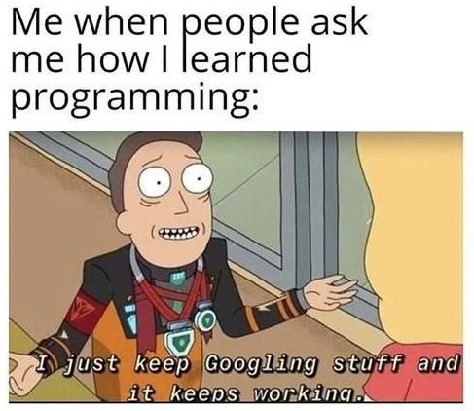
Keep in mind
It is very limited time for a broad topic
I will not try to cover many details.
It is designed to provide just an overview on computation and a concrete set of starting materials.
Most of these are selected online materials (with references) that is tailored to run on Biowulf.
Questions and feedback are welcome in the workshop and in the google sheet.
Questions & Feedback
& Youtubing

Slide 5
Agenda -- day 1, single cell RNA-seq
9-10AM, setting up the system
Get to know each other
Set up pseudolink (NIEHS_NGS) to the /data/studentxx folder
Copy workshop files to NIEHS_NGS
Initiate jupyter lab
Questions and break (10 minutes)
10:30-11AM, Introducing single cell RNA-seq 30 minutes.
11-12AM, From bcl, fastq to expression matrix
Convert bcl to fastq files using the tiny-bcl folder 15 minutes
Using cellranger count to get expression matrix
12-12:30PM, Questions and break
12PM-1PM, Run basic pipelines
Using Seurat pipeline to import alignment result do QC, and normalization.
(optional) Using Scanpy pipeline to import alignment results to do QC, and normalization.
1PM-1:30PM, use RNA velocity to infer trajectory.
Run Velocyto CLI to get the reads aligned to non-spliced region.
Import into scVelo (python) to do trajectory inference.
1:30PM—2PM, Prepare for day2
Download and install IGV, IGB

Slide 6
Agenda -- day 2, bulk RNA-seq and ChIP-seq
Part II, Bulk RNA-seq
9:00-9:15AM, connect to biowulf
9:15-9:30AM, introduction to bulk RNA-seq
9:30-10AM, From Fastq files, alignment with RSEM, Tophat
10AM-10:30AM, Visualize the output using IGV.
10:30-11:00AM, Normalization and differential analysis with DESeq2
Questions and break
Part III, Chip-seq
11:30AM-12PM, Introduction to ChIP-seq analysis
12:00-12:15AM, Alignment to genome using Bowtie2
12:15-12:25AM, Use MACS2 to call peaks, and use Homer to call differential peaks
12:25-12:45AM, Use IGB to visualize peaks
12:45-1:15AM, Use CEAS to annotate peaks and summarize statistics.
1:15am -1:45AM, Use Homer to study TF binding site analysis. And use GREAT for gene ontology.
Review & Summary

Slide 7
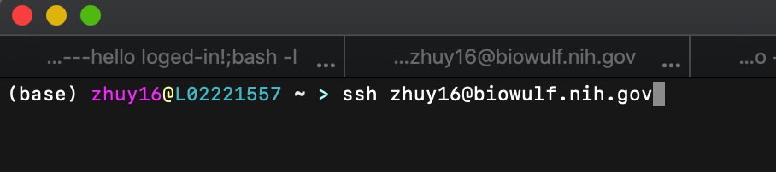
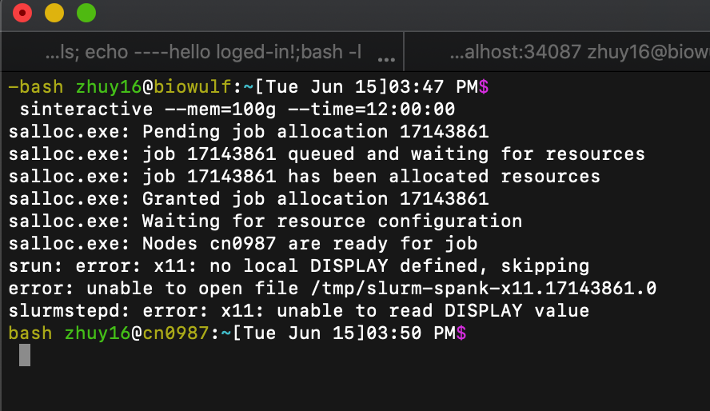
Log in to biowulf and go to the folder
(code can be copied from Getting_started.md)
ssh user_id@biowulf.nih.gov
# set up sudo links to your storage folder:
module load tmux
tmux new # get a detachable terminal
sinteractive # get a basic compute node
cd
ln -s /data/user_id NIEHS_NGS
# copy the workshop material to your scratch folder:
cp -r /spin1/users/classes/NIEHS_NGS/workshop ~/NIEHS_NGS/

Slide 8
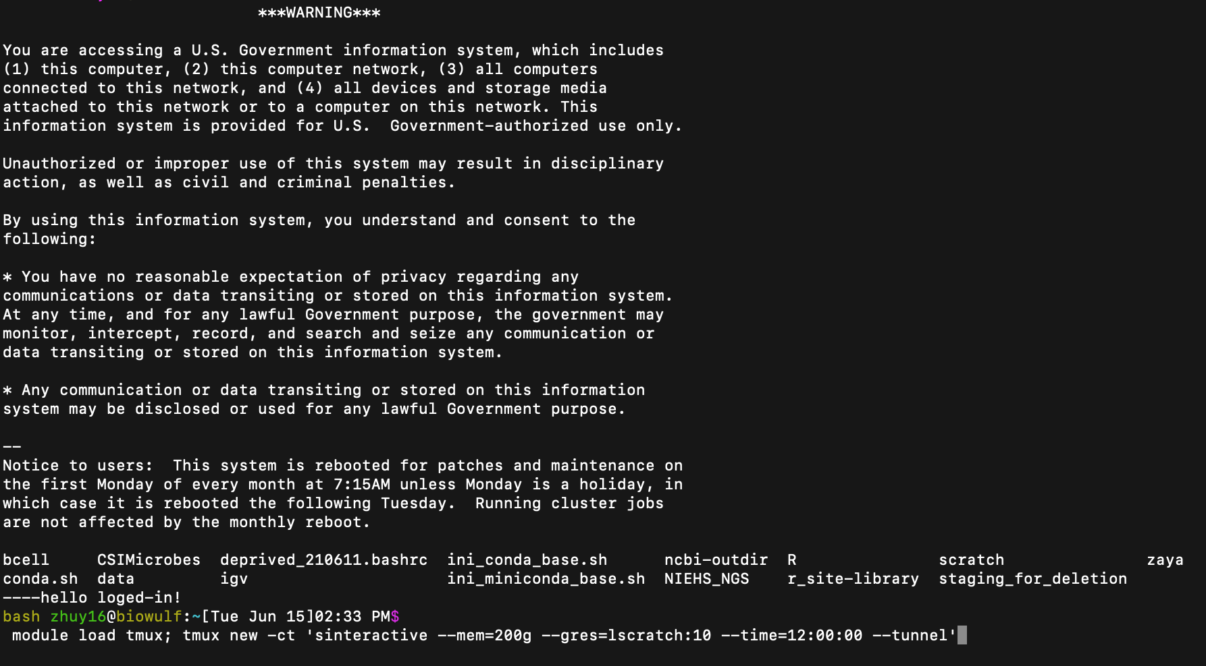
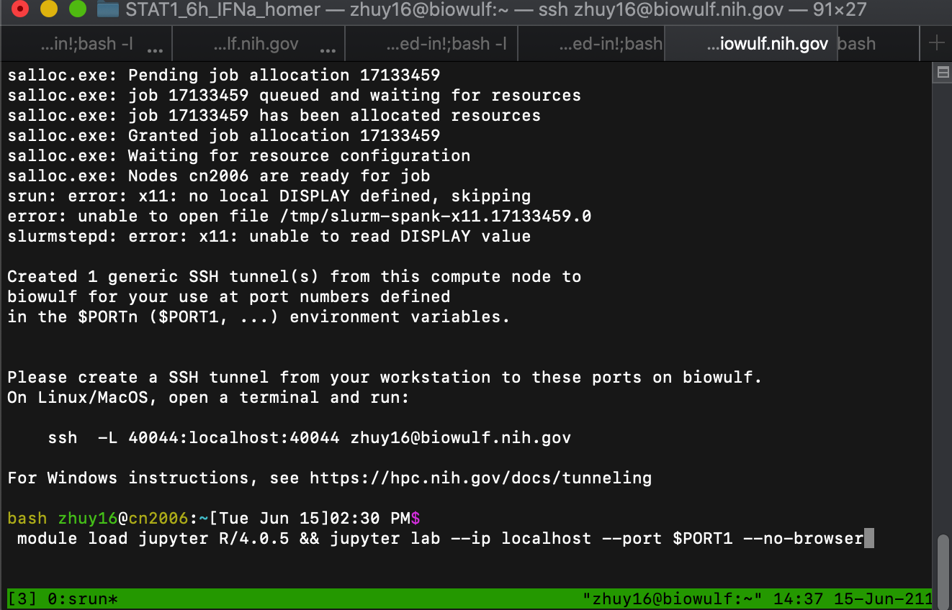
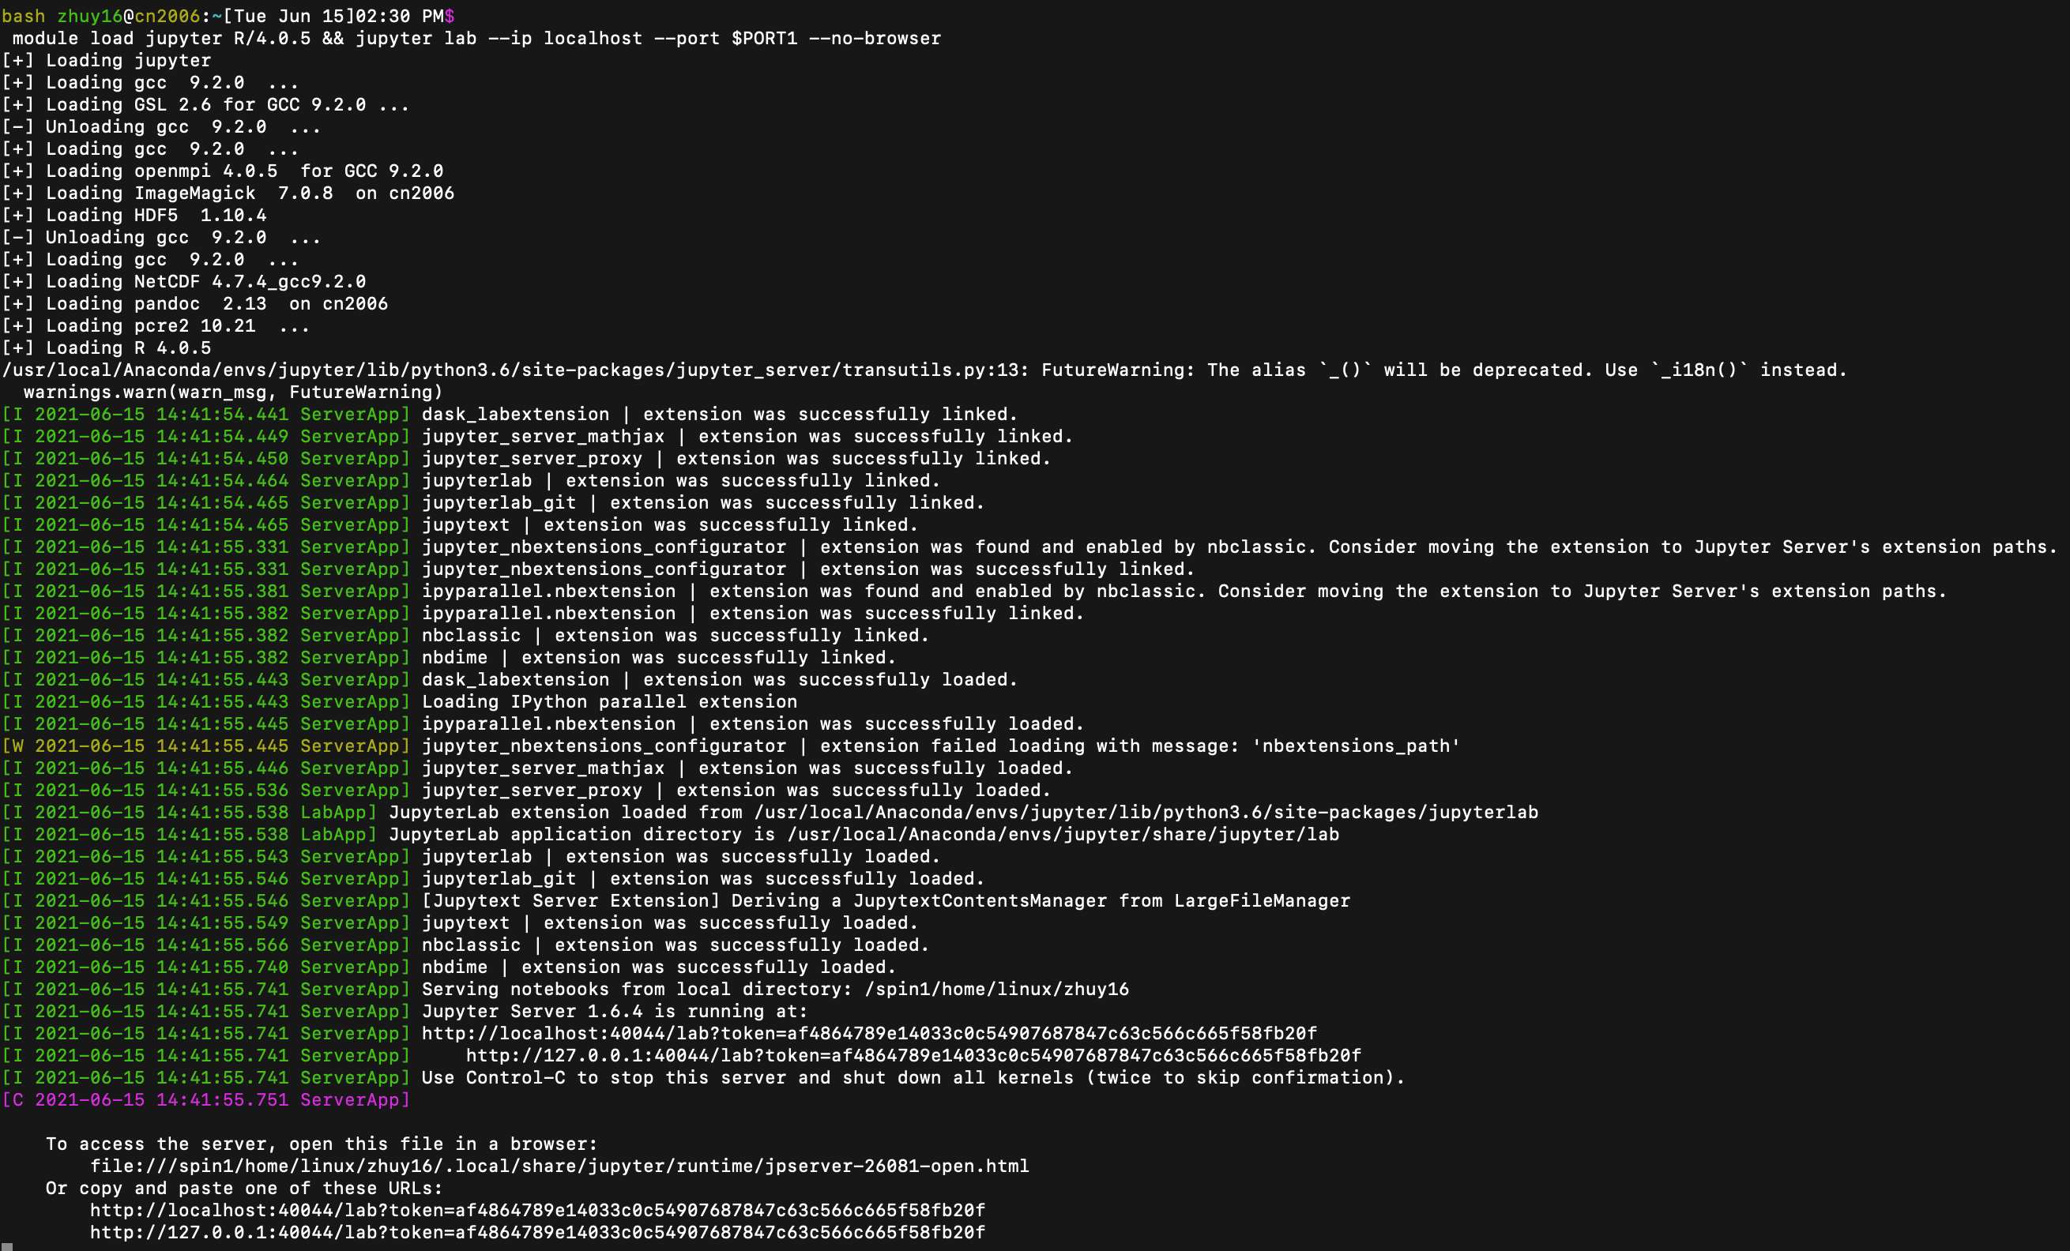
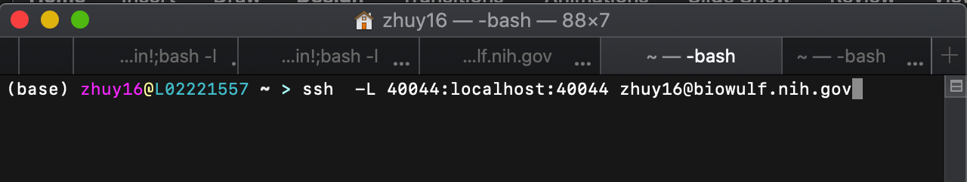
Start up the jupyter lab, --our working interface
Log in screen
# Open another terminal
ssh studentxx@biowulf.nih.gov
Enter password
module load tmux
module load tmux; tmux new -ct 'sinteractive --mem=50g --time=12:00:00 --tunnel’
# Copy the tunnel script to another (3rd) terminal, execute and enter password, to establish a ssh tunnel between local computer and the work node.
module load jupyter R/4.0.5 && jupyter lab --ip localhost --port $PORT1 --no-browser
# wait until an URL link appears, copy it to your web browser, to get connected to biowulf through the jupyter lab interface.
URL
TUNNEL

Slide 9
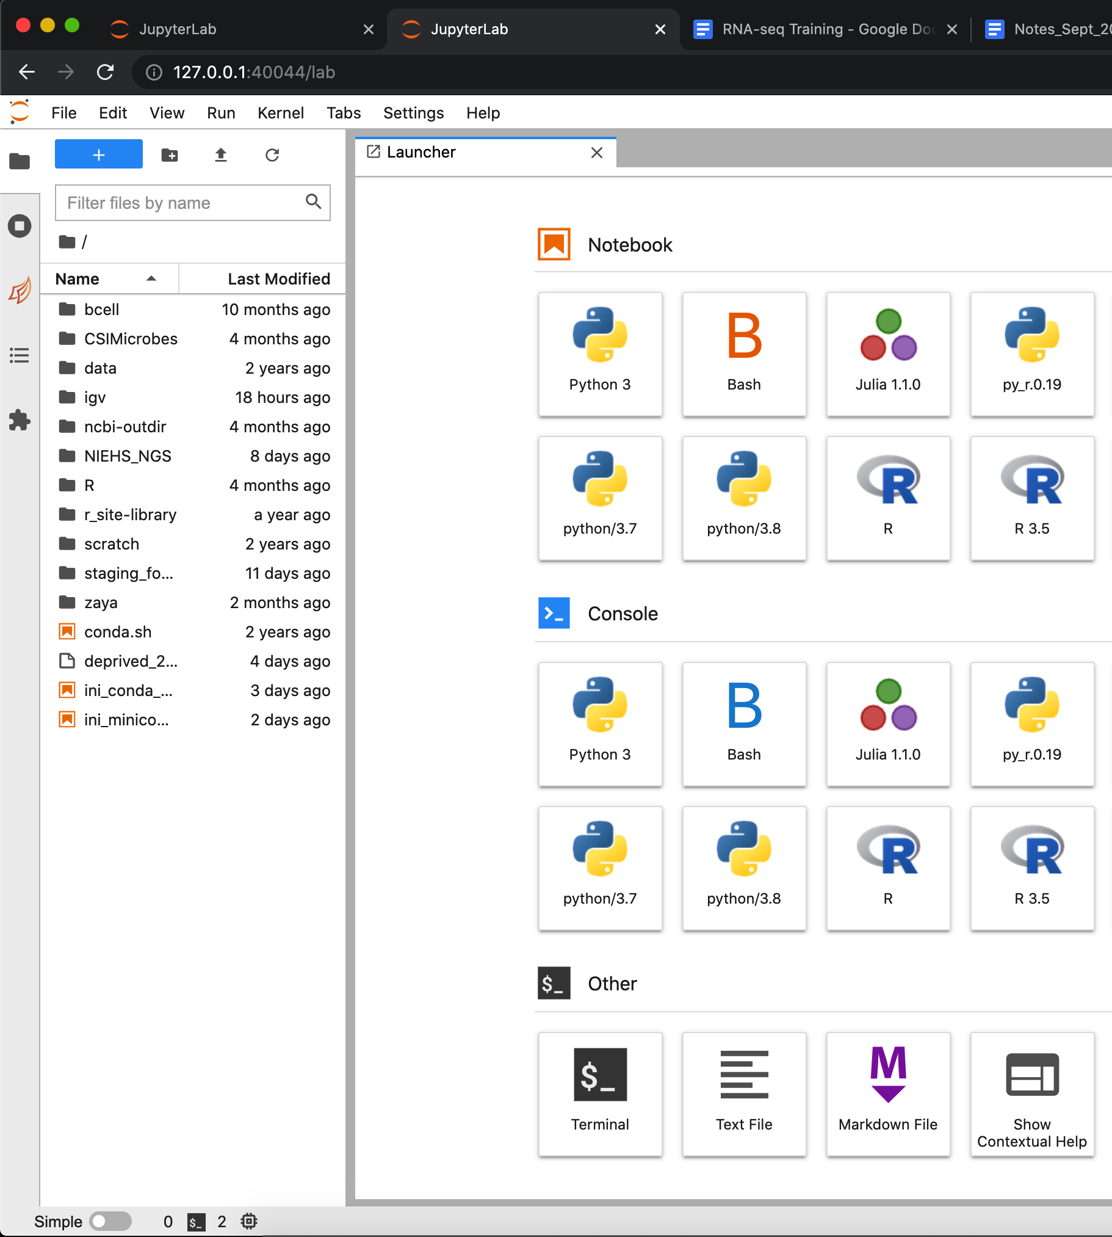
Jupyter lab
Navigate files
Bash terminal
Control kernels
Jupyter notebooks for
Kernals
Bash
R
Python
Julia
Document analysis
Git version control
Report results

Slide 10
Single cell RNA-seq
Evolution of single cell technologies
Introduction to 10X genomics
Bioinformatic workflow

Slide 11
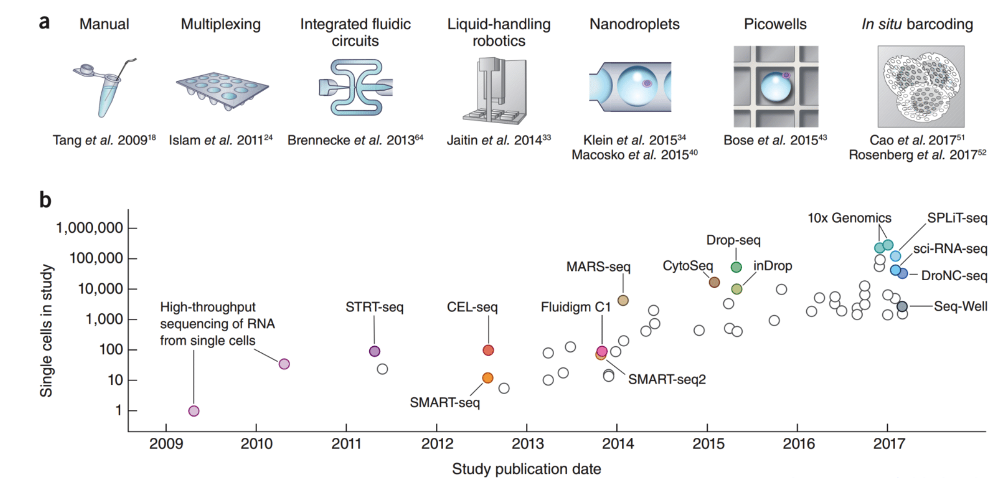
Evolution of single cell technologies
Exponential scaling of single-cell RNA-seq in the past decade.
Nature protocols 13;4;599-604)

Slide 12
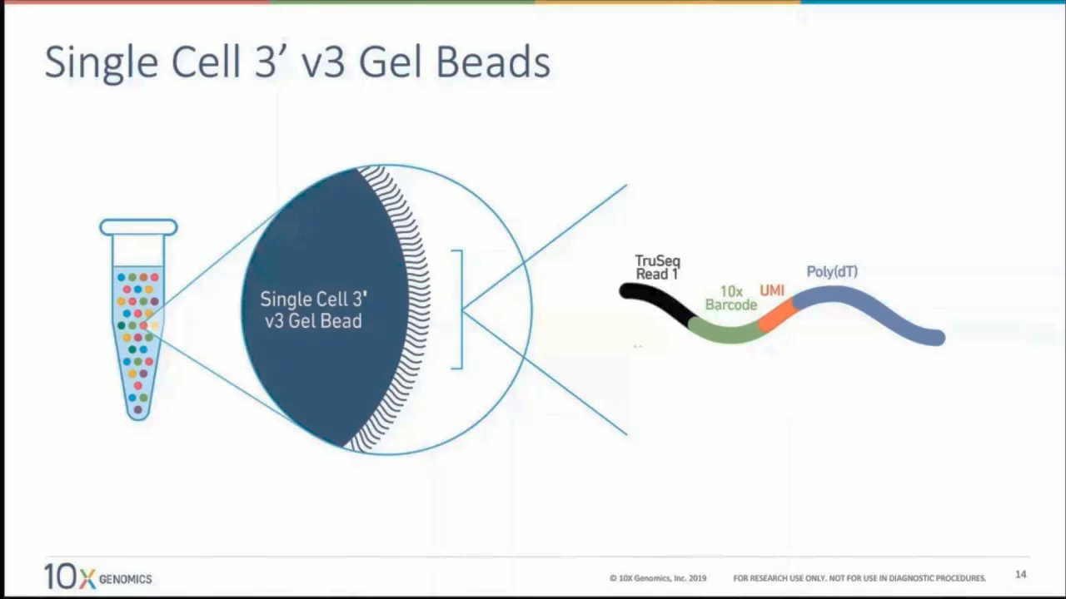
10X Genomics– commercial solution that facilitates automatic generation of Gel Bead-in-Emulsion (GEM)
In a GEM droplet, one hydrogel bead and one cell were captured
One hydrogel bead is attached with millions of poly-T primers with an identical unique barcode.
cDNA and the second-strand synthesis in the droplet
Droplets (~1nL) are disrupted to collect all the barcoded samples for highly multiplexed library preparation and sequencing
Standardized automation and reagent has made sequencing library preparation very efficient
Lysis in droplet &
RT and second strand synthesis
cDNA pool and library preparation

Slide 13
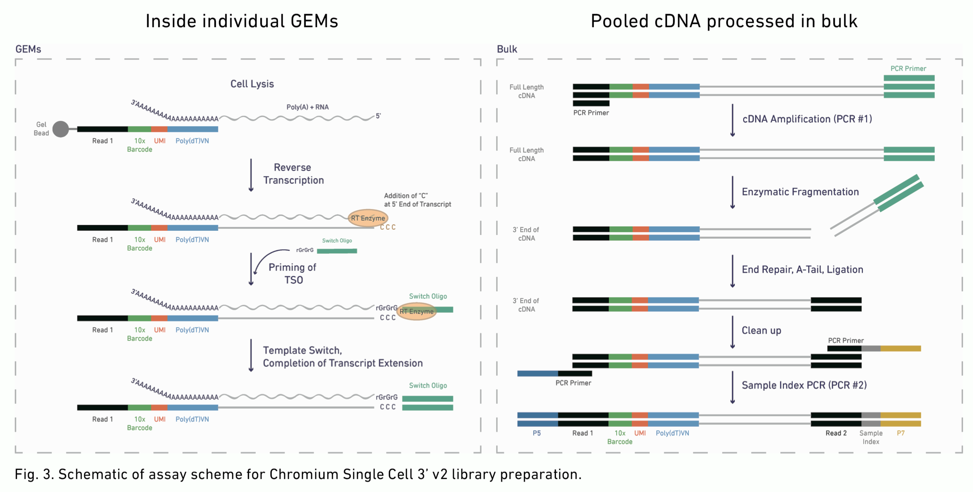
(Gel Bead-in-Emulsion)
https://assets.ctfassets.net/an68im79xiti/4fIy9tr6qQuCWamIii0iEa/40658acce7a6756e38537584897840e3/CG000108_AssayConfiguration_SC3v2.pd
Notes:
https://assets.ctfassets.net/an68im79xiti/4fIy9tr6qQuCWamIii0iEa/40658acce7a6756e38537584897840e3/CG000108_AssayConfiguration_SC3v2.pd

Slide 14
Next-seq reading the paired ends
10XBC: 16 bp barcodes 2^16=65536 possible unique cells
UMI, 2^12=4096 unique copies of mRNA can be distinguished for each gene
Read2 will read into cDNA to identify the identity of the gene
Sample barcode, identify the batch of your library sample
All information will be summarized by the Cellranger software
https://github.com/niaid/NGS_Intro/blob/master/notes/sequence_qc_class.md
Notes:
https://github.com/niaid/NGS_Intro/blob/master/notes/sequence_qc_class.md

Slide 15
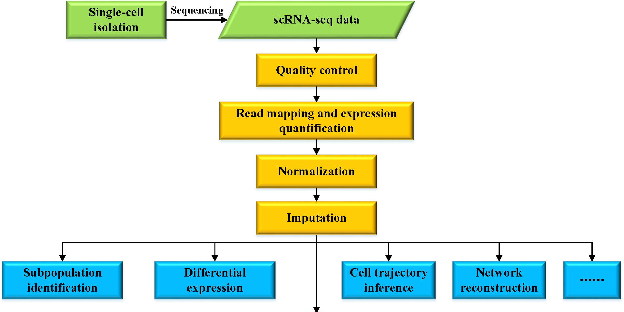

SMART-seq2 & 10x Genomics wetlab protocols
Integrative toolkits
Seurat
Scanpy
Cellranger
Scaling up
Scanpy
Deep learning
Dry lab analysis
( )
???
Magic, SAUCIE
Dimension reduction
Batch/integration
Cell type Annotation
RNA velocity, Slingshot
Identify Gene modules
WGCNA
clusterProfiler
Functional annotation
Gene regulatory networks
SCENIC, bnlearn
15
https://www.frontiersin.org/files/Articles/441123/fgene-10-00317-HTML/image_m/fgene-10-00317-g001.jpg

Slide 16
SMART-seq2 & 10x Genomics protocols
Integrative toolkits
Seurat
Scanpy
Cellranger
Scaling up
Scanpy
Deep learning
( )
???
Magic, SAUCIE
Dimension reduction
Batch/integration
Cell type Annotation
RNA velocity, Slingshot
Identify Gene modules
WGCNA
clusterProfiler
Functional annotation
Gene regulatory networks
SCENIC, bnlearn
https://www.frontiersin.org/files/Articles/441123/fgene-10-00317-HTML/image_m/fgene-10-00317-g001.jpg

Slide 17
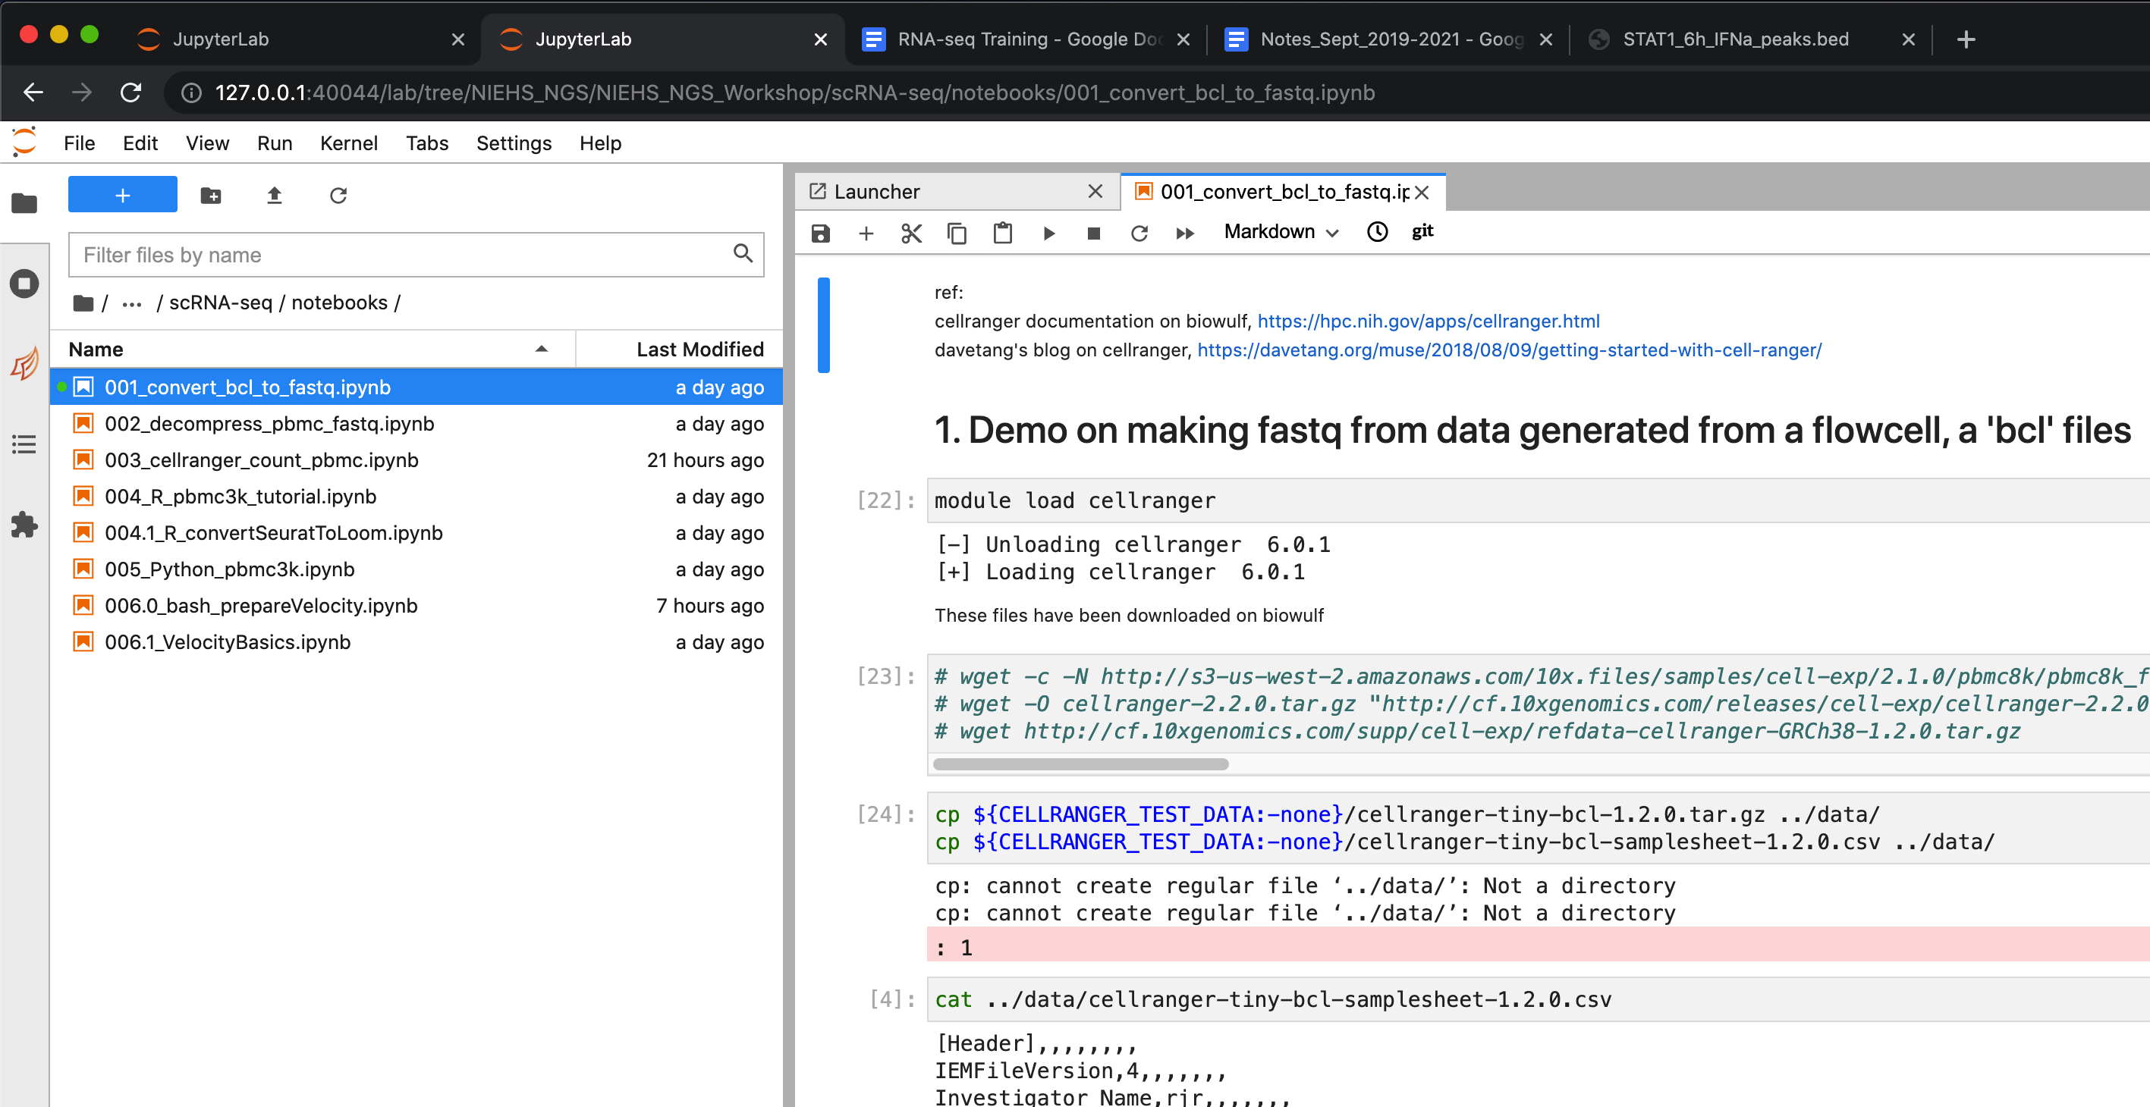
Let’s go to Jupyter lab…
There notebook files are in github as well
Step 001, make fastq from bcl files

Slide 18
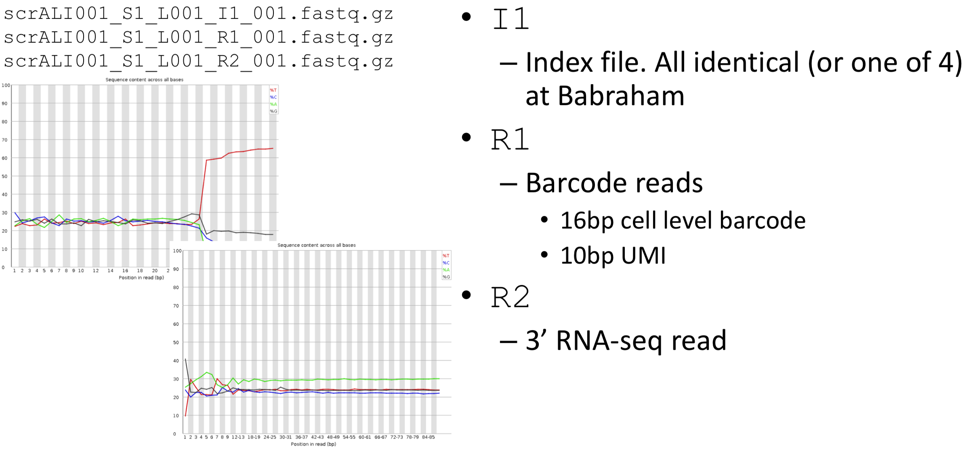
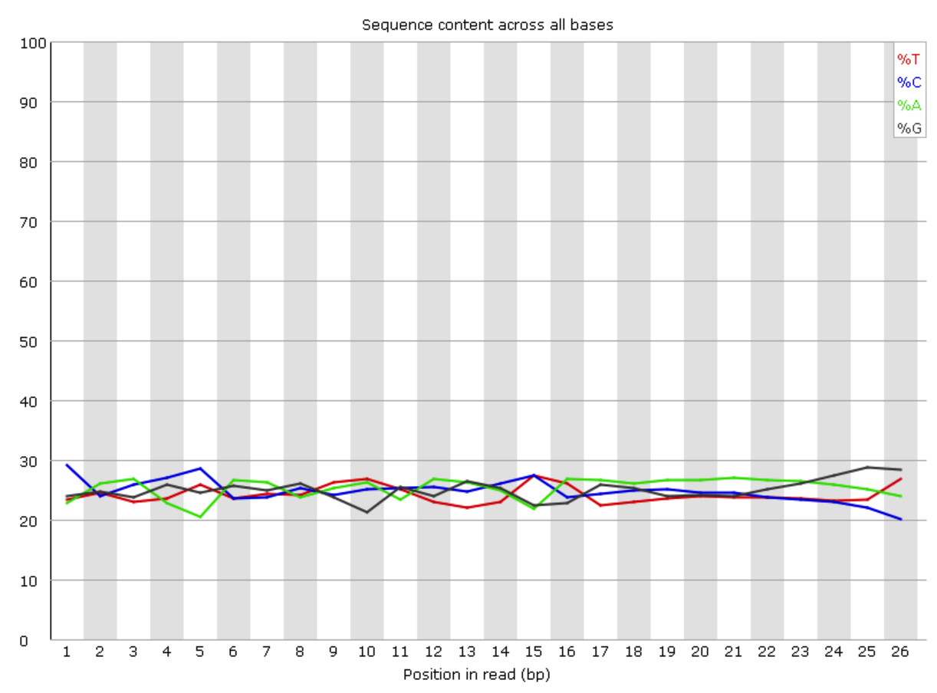
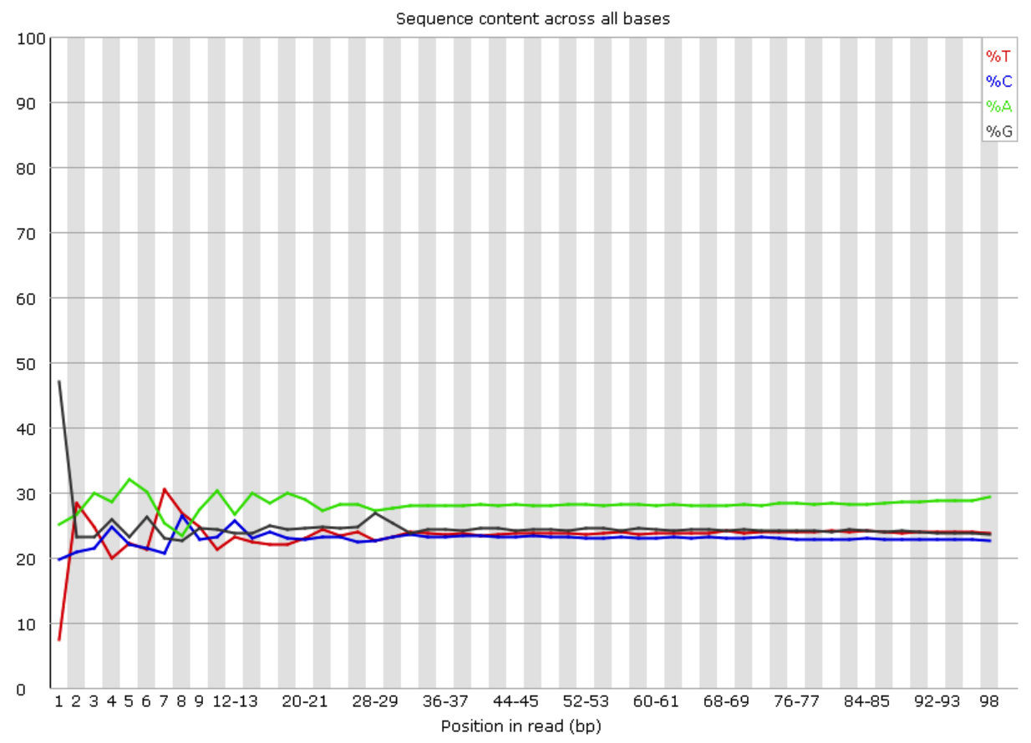
QC on sequencing results
https://support.10xgenomics.com/single-cell-gene-expression/software/pipelines/latest/using/count

Slide 19
Alignment results and Quality Controls
Cellranger
cellranger mkfastq
cellranger count
cellranger aggr for multiple batches
Quality controls
FASTQC on fastq files
Number of cells per experiment
Number of UMI per cell
Number of genes per cell
Percentage of mitochondrial reads
Removal of doublets/aggregates

Slide 20
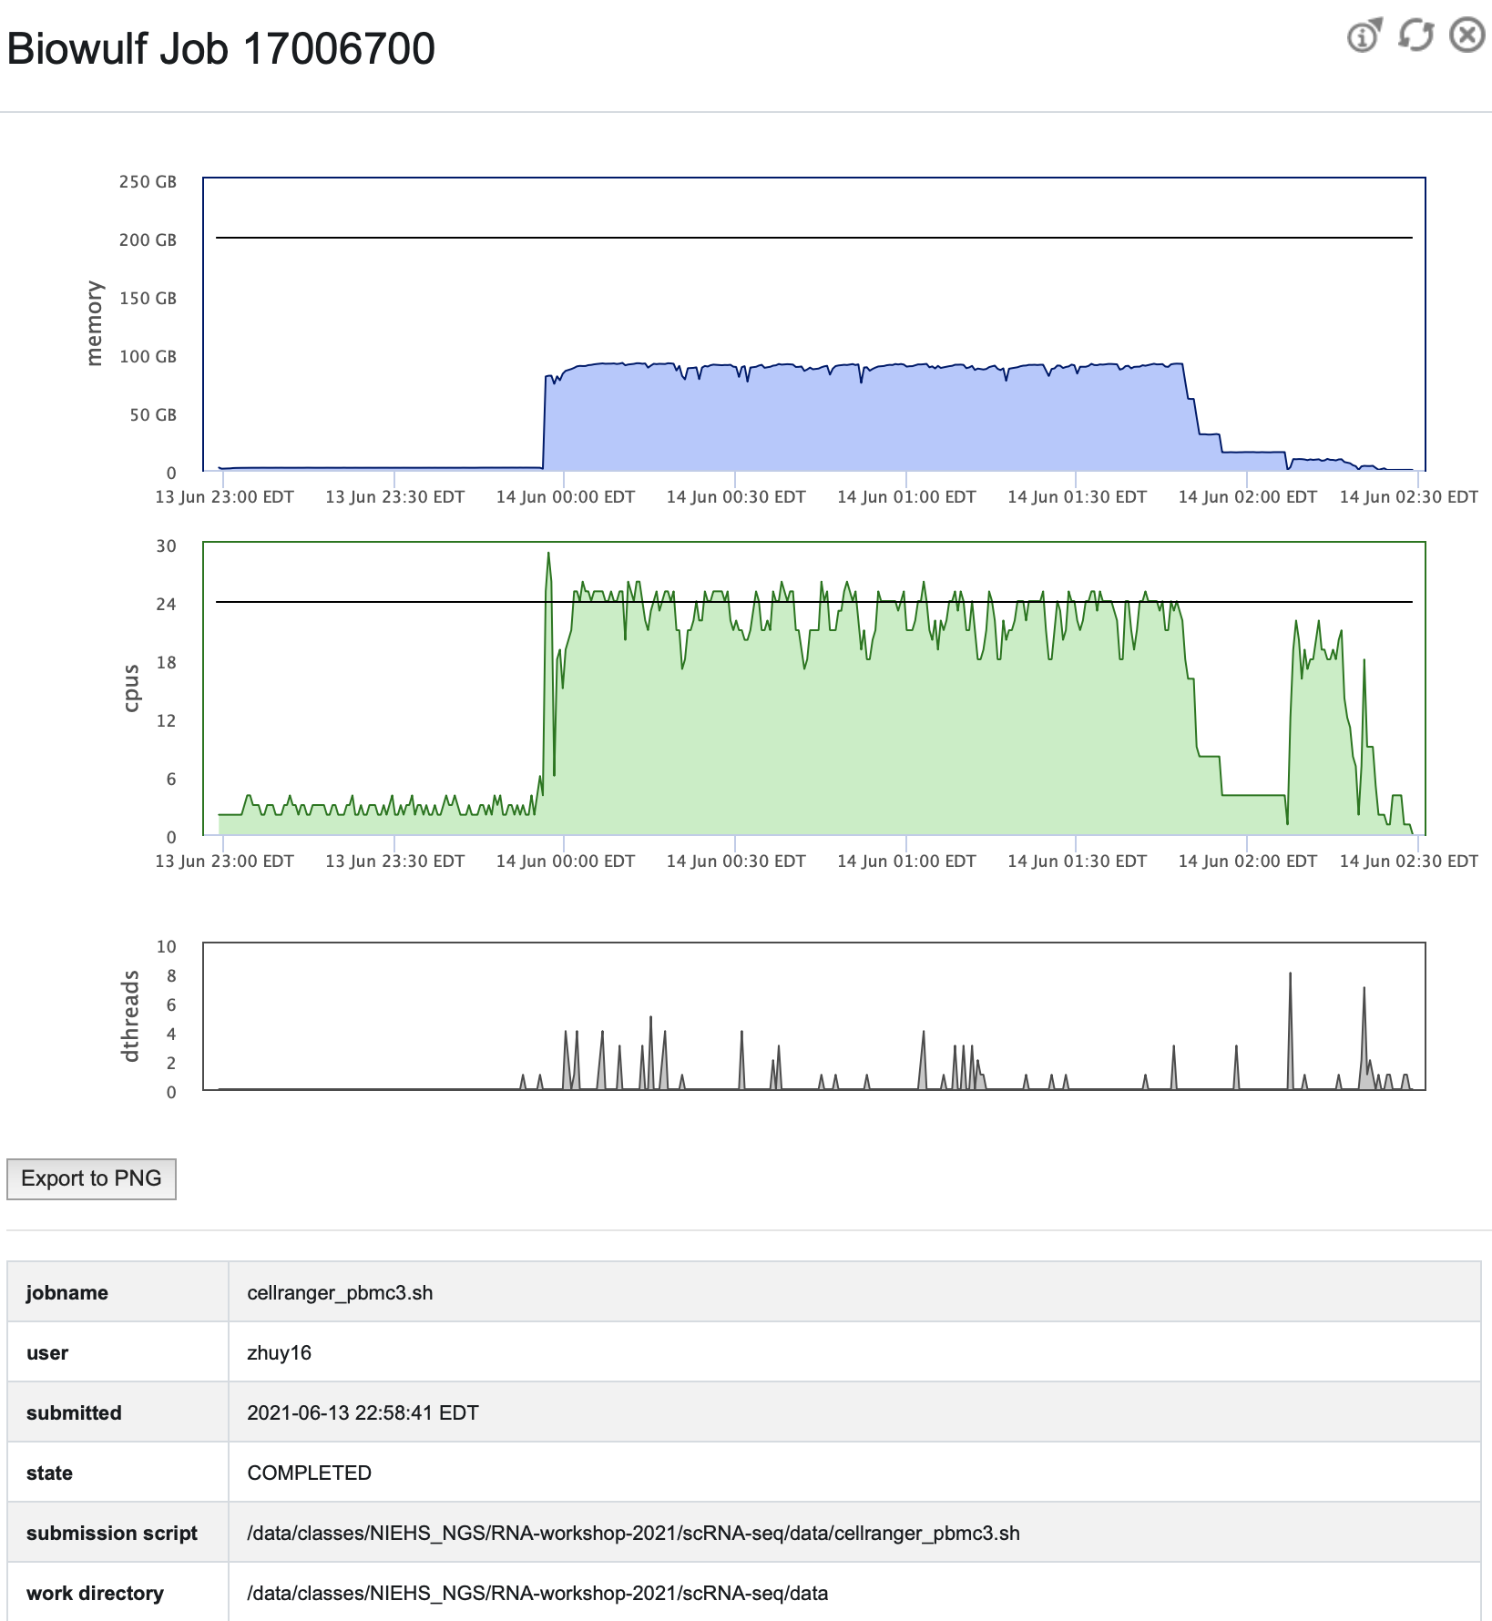
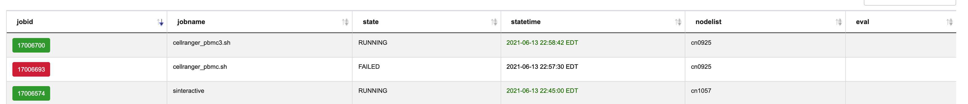
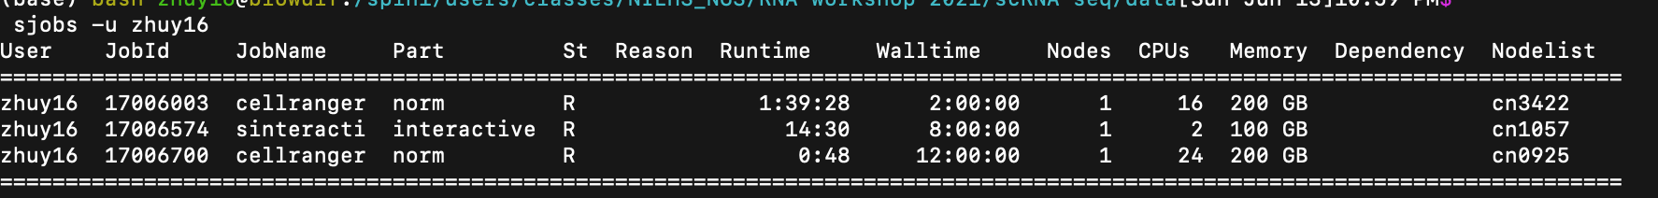
Monitoring jobs status on biowulf
Login to the user dashboard to monitor
https://hpc.nih.gov/dashboard/
Sbatch jobs can be listed on terminal using
sjobs -u user_id

Slide 21
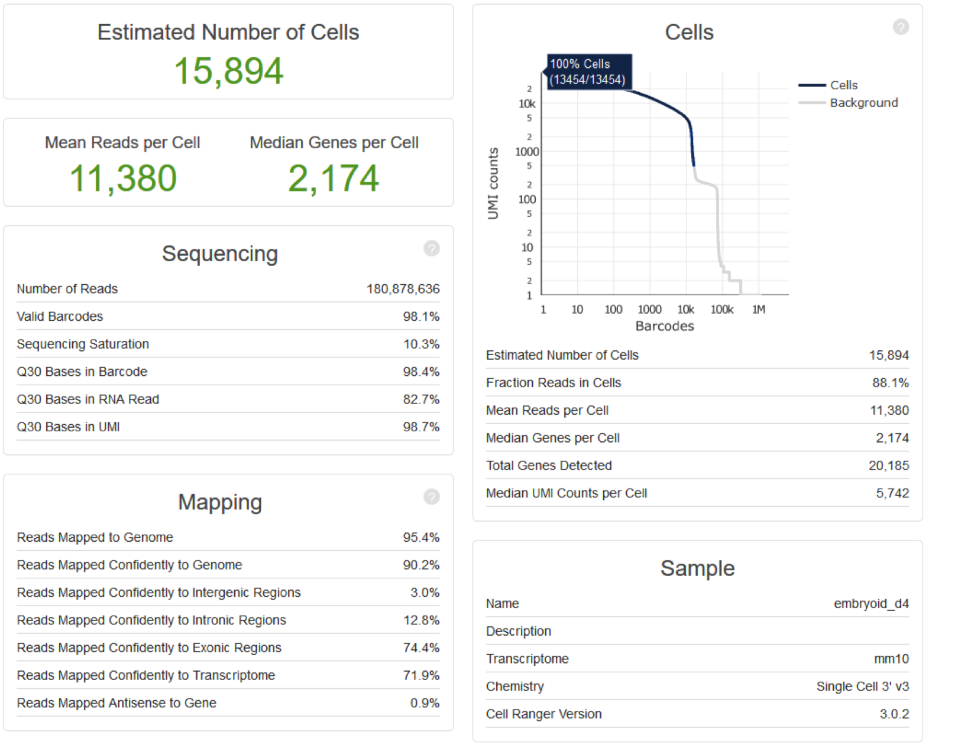
Cellranger count report
FATSTQ
I1.FASTQ
R1.FASTQ
R2.FASTQ
Cellranger
report summary …

Slide 22
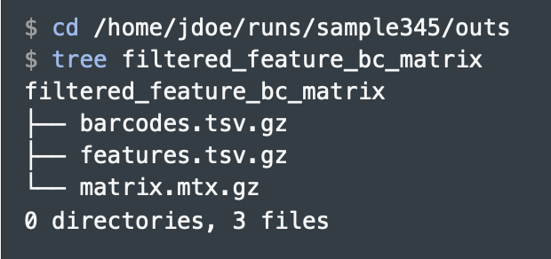
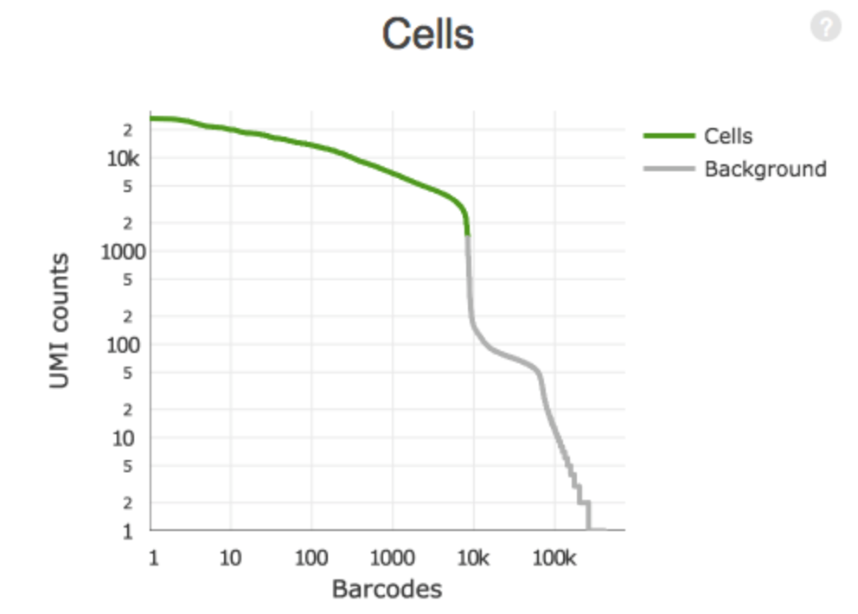
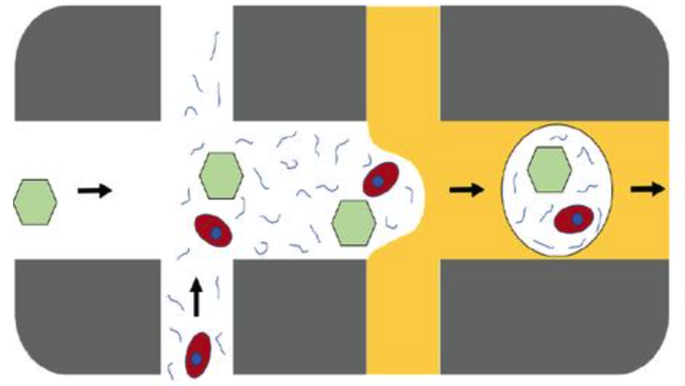
cellranger count output
Output:
Reads level
Cellranger
cellranger mkfastq
Generate fastq files from image “.bcl” files
cellranger count → sparse matrix
umi, unique molecule identifier
cellranger aggr
Combine count data from multiple batches
(For CITE-seq and HASH-tag)
Cite-seq-count
--cells
--genes
--sparse matrix
Broken cells/
free floating RNA and
Empty droplets
Ranked by number of associated UMIs
https://davetang.org/muse/2018/08/09/getting-started-with-cell-ranger/

Slide 23
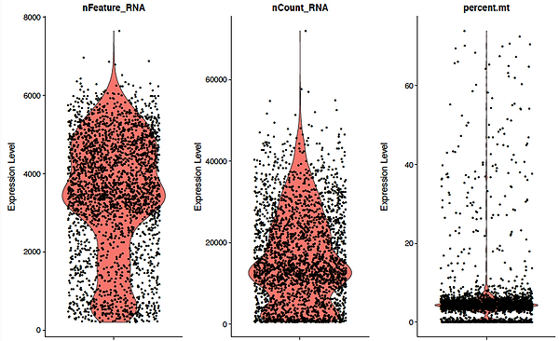
Seurat -- Quality Controls
Quality of reads – FASTQC
Percentage of mitochondrial reads
Too many mitochondria reads may indicate that cells are dying/dead/broken
Case-by-case, the range may vary with method of library prep methods/cell type
How many cells are you capturing?
Typically few thousands in each 10X run
The sequencing depth
Are they acceptable in the field (minimal 2,000 reads /cell?) determined by the Cellranger
Alignment to the genome and exons
Should be 90-100% to the genome
A reasonably narrow range 70-80% to the exons
(Could be 30% to exons if you use nucleus, which contain lots of introns)
Expected markers expressed?
Highly expressed genes, cell type markers, automatic detection such as scMCA etc
Be prepared to see differences between RNA (because of the depth and dropouts) and proteins.
Confounding factors?
Batch effect?
Is your dimension reduction capturing biological or technical variations?
Can be evaluated by WGCNA and visualization in PCA or tSNE
https://www.biostars.org/p/377422/

Slide 24
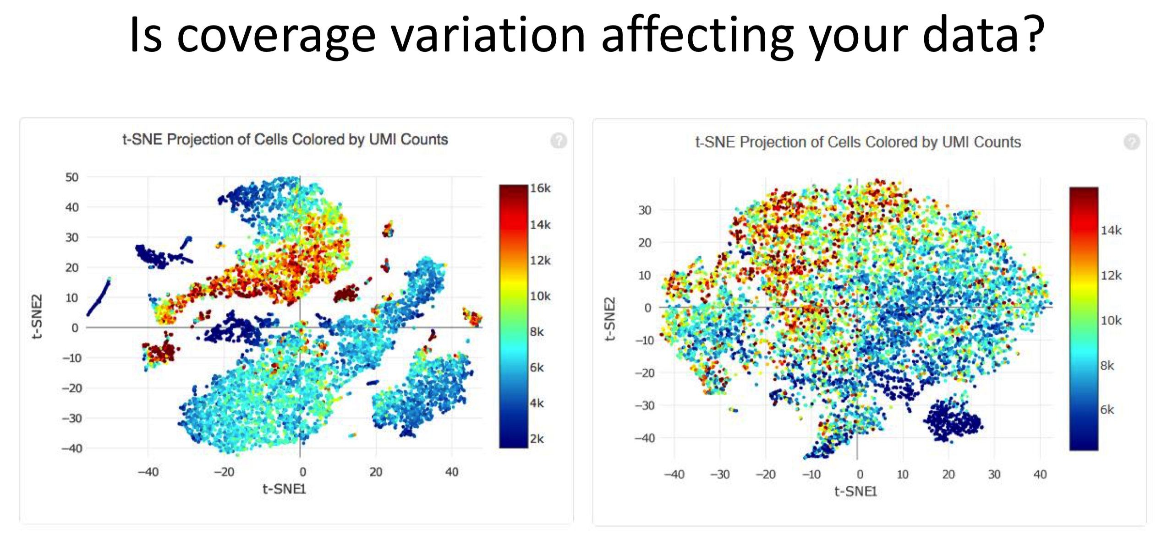
UMI dominate the variance?
Need to do batch correction?
Is the level of separation enough/expected?
(to much background RNA?

Slide 25
Cell-based analysis
Clustering and annotate the biological identities of clusters
Inference of trajectory
Batch correction/data integration.
comprehensive workflow/toolkits

Slide 26
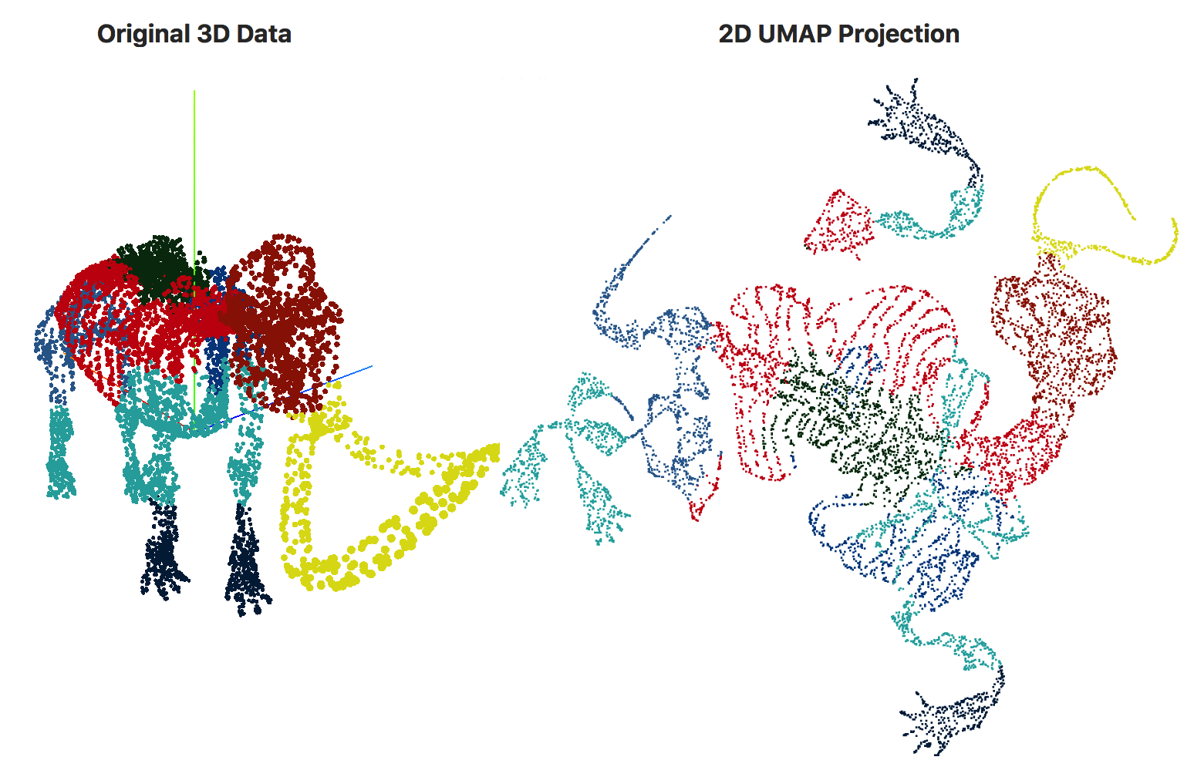
Dimension reduction--an intuitive illustration
Screenshot by Mariam from
https://pair-code.github.io/understanding-umap/

Slide 27
Dimension reduction
Dimension reduction
PCA
Linear reduction
Based on distances
2D structure in PCA depends on certain observed dominant variations
Often not sufficient for large number of cells
tSNE
Non-linear reduction
Attention to local similarity
Global shape is less meaningful
Add new data changes the whole pattern
UMAP
Consider both global and local structure
Learnt embeddings can be saved for new batch of data
AutoEncoder
Fast algorithm to handle up to millions of cells
https://towardsdatascience.com/deep-learning-for-single-cell-biology-935d45064438
Notes:
Comparison: https://towardsdatascience.com/deep-learning-for-single-cell-biology-935d45064438
Comparison: https://www.youtube.com/watch?v=4NlvatkpV3s
https://www.youtube.com/watch?v=RJVL80Gg3lA
https://github.com/lmcinnes/umap

Slide 28
Comprehensive toolkits

Slide 29
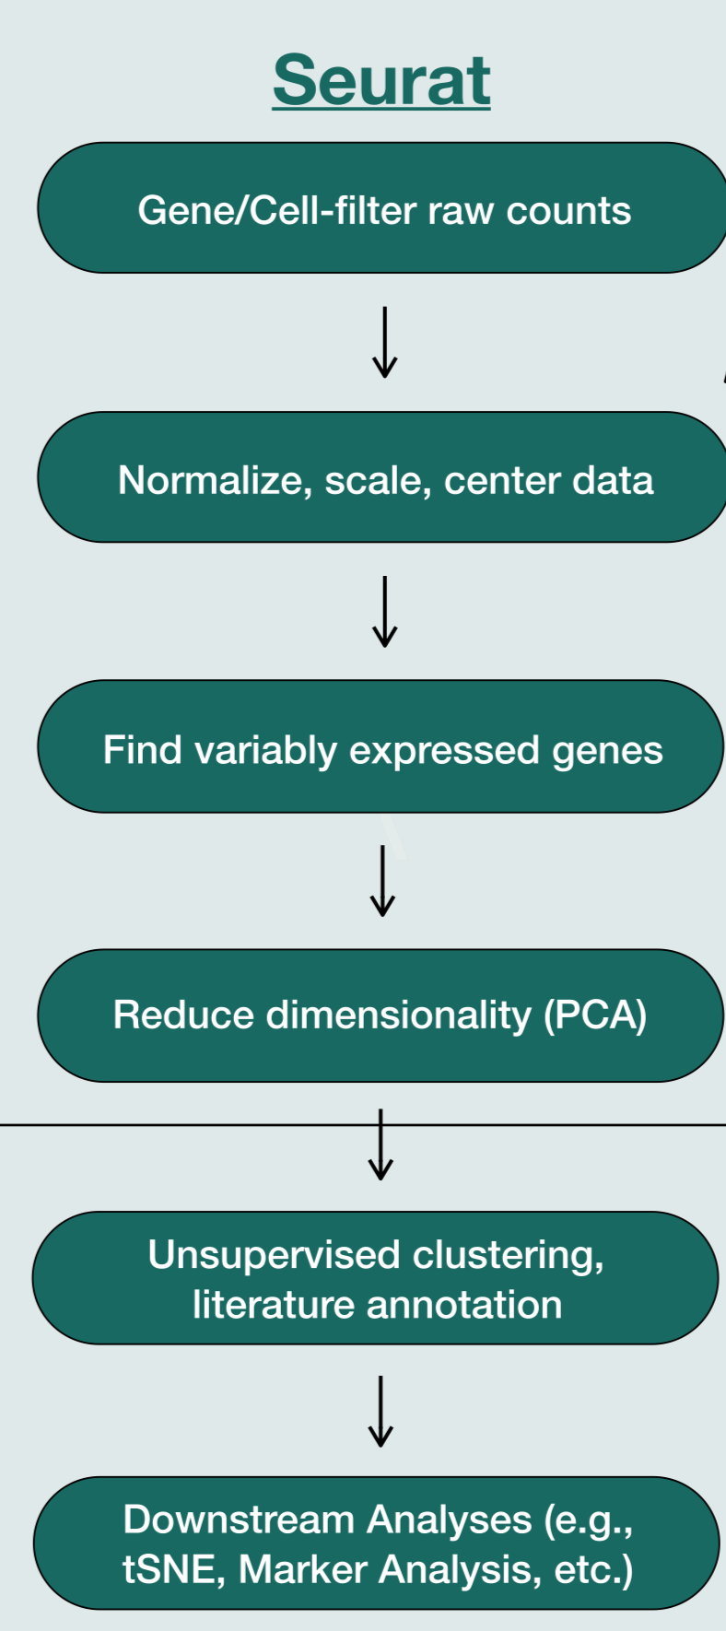
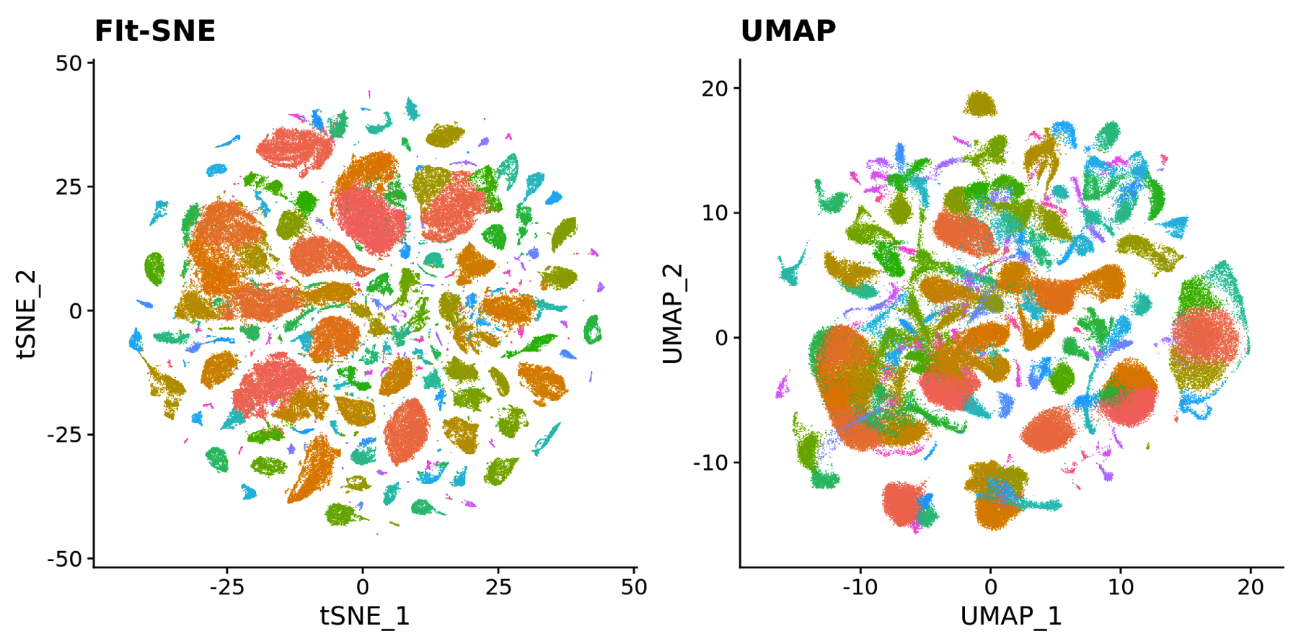
Comprehensive pipeline tools for explorative analysis -- Seurat
Seurat pipeline
General QC assessment
Cell type annotation
Batch correction and meta analysis
Multimodal analysis (for CITE-seq, Hash-tagging, ATAC-seq)
Comparative analysis across different conditions
https://satijalab.org/seurat/vignettes.html
https://satijalab.org/seurat/vignettes.html
Notes:
https://www.cell.com/cell-systems/pdfExtended/S2405-4712(19)30073-0

Slide 30
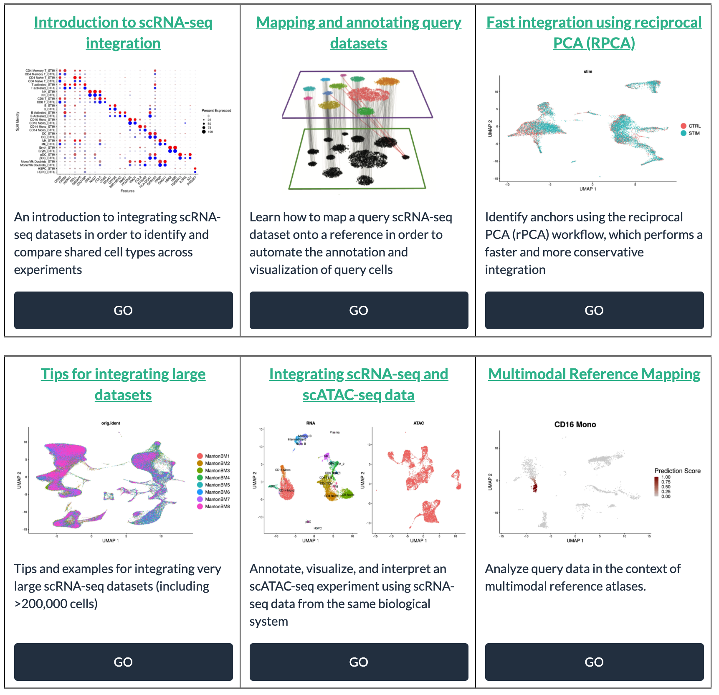
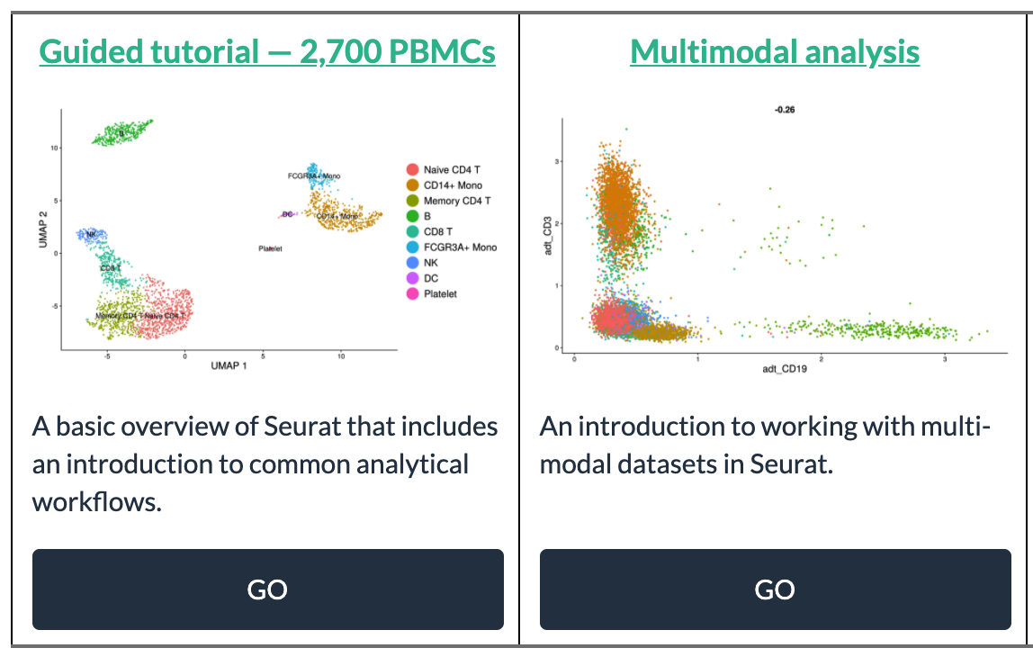
Multiple vignettes for different tasks
Multiple pipelines for integrating data
Basic pipeline: QC,
Dimension reduction
Clustering
Marker identifications
Integrating with CITE-seq, HASH-seq
Start from here

Slide 31
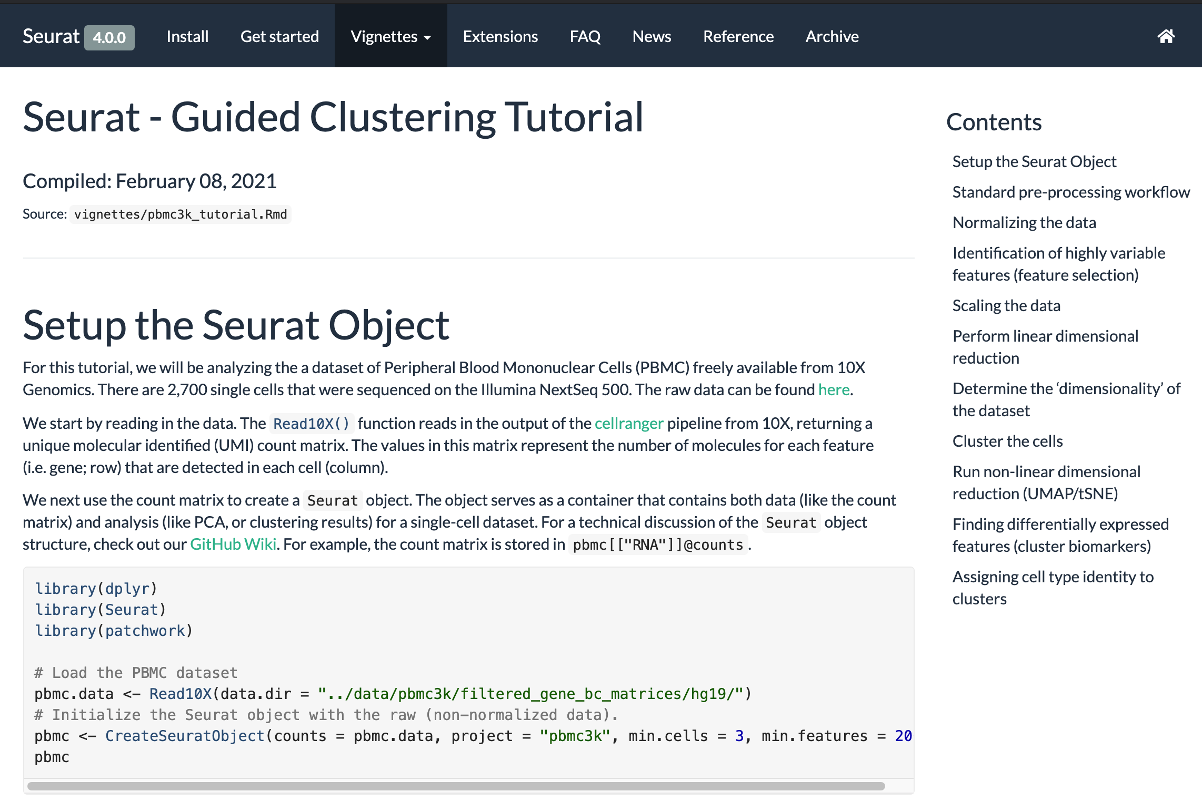
Download vignette/tutorial to use on your data
Linked to github for you to download the code.
Follow through the tutorial using sample data included in the package.
Change the input file to your our data to use the analytic pipelines.
(.Rmd can be converted to ipynb
To be handled in Jupyter Notebooks)

Slide 32
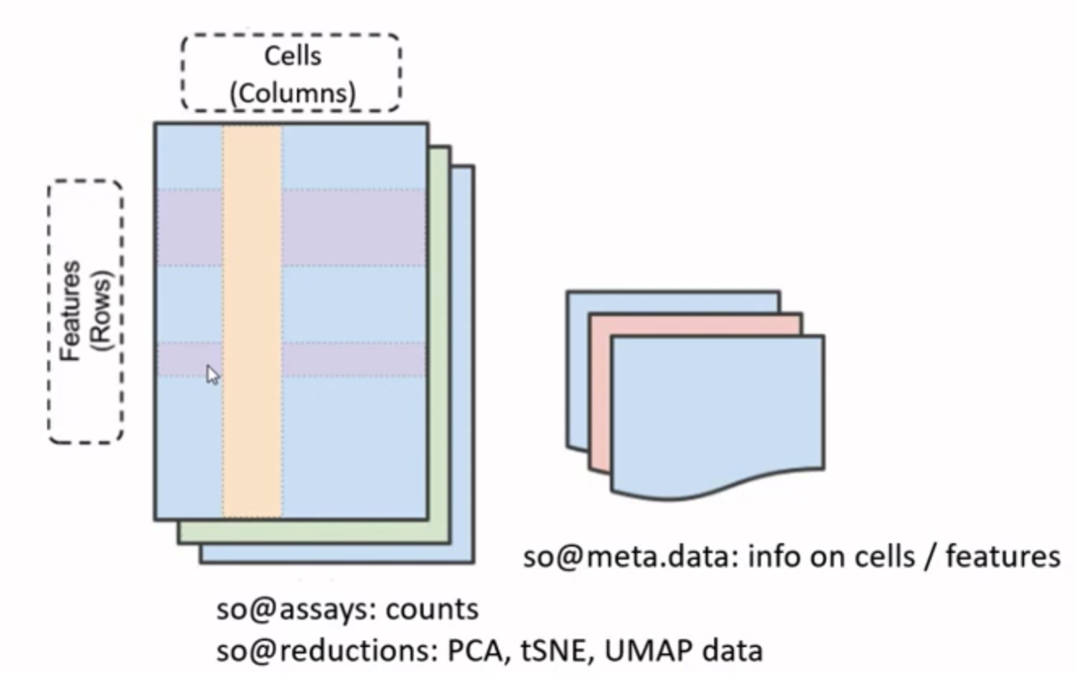
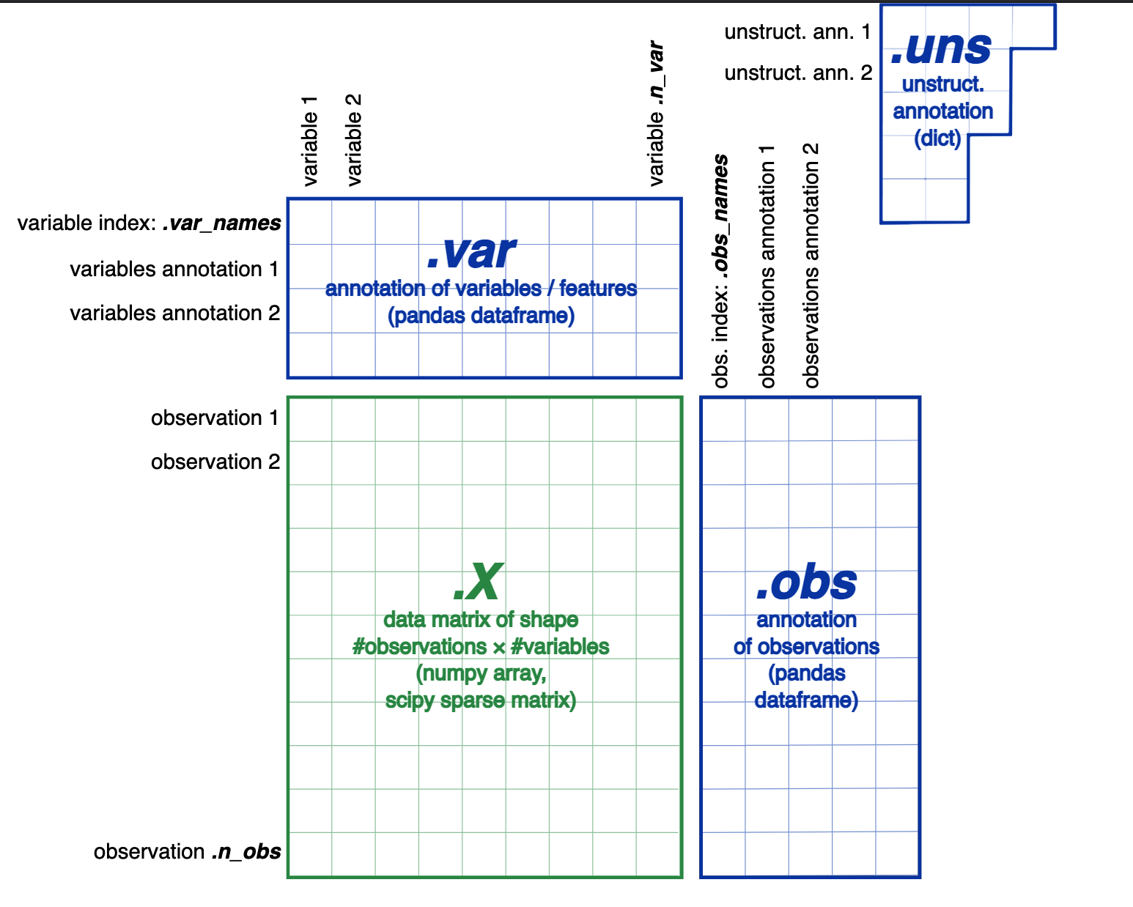
R vs Python, Object-Oriented Programming (OOP)
Seurat Object in Seurat
Anndata Object in Scanpy

Slide 33
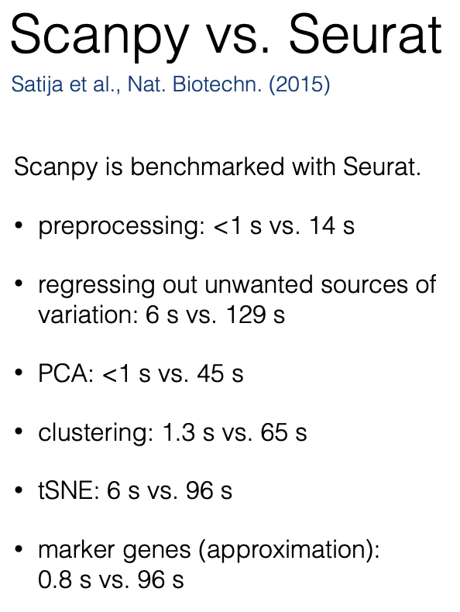
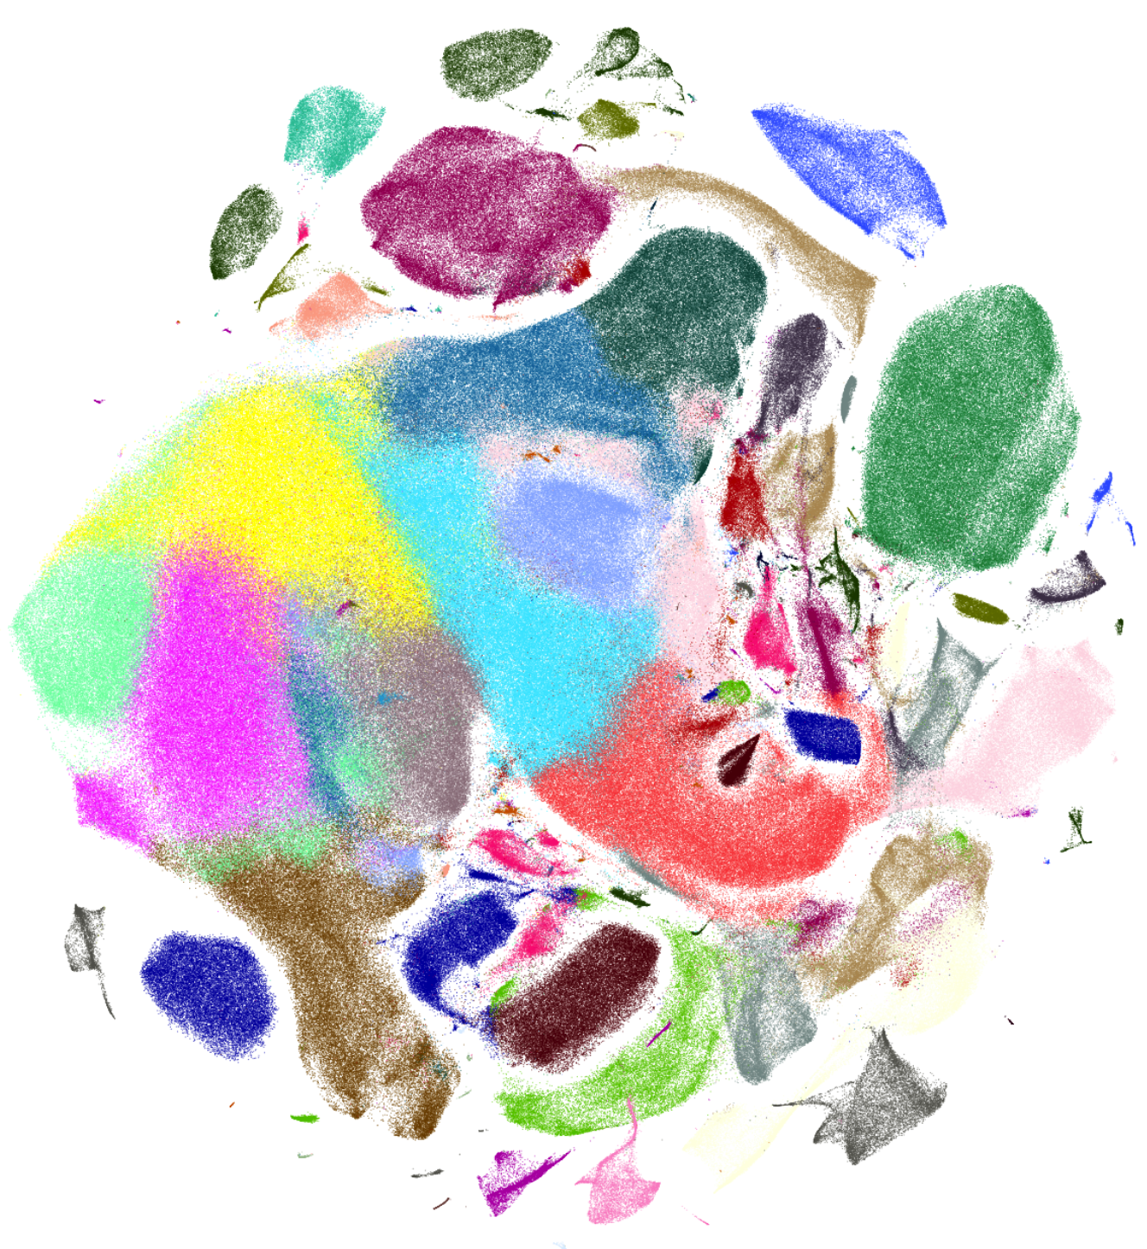

Scale up with python implementations
Python packages/toolkits are increasingly popular
scanpy pipeline
scVelo pipeline
Some has a R rapper.
Use python in R through Reticulate
Use R in python through rpy2
tSNE plot of
1300000 neurons by scanpy
https://scanpy.readthedocs.io/en/stable/tutorials.html

Slide 34
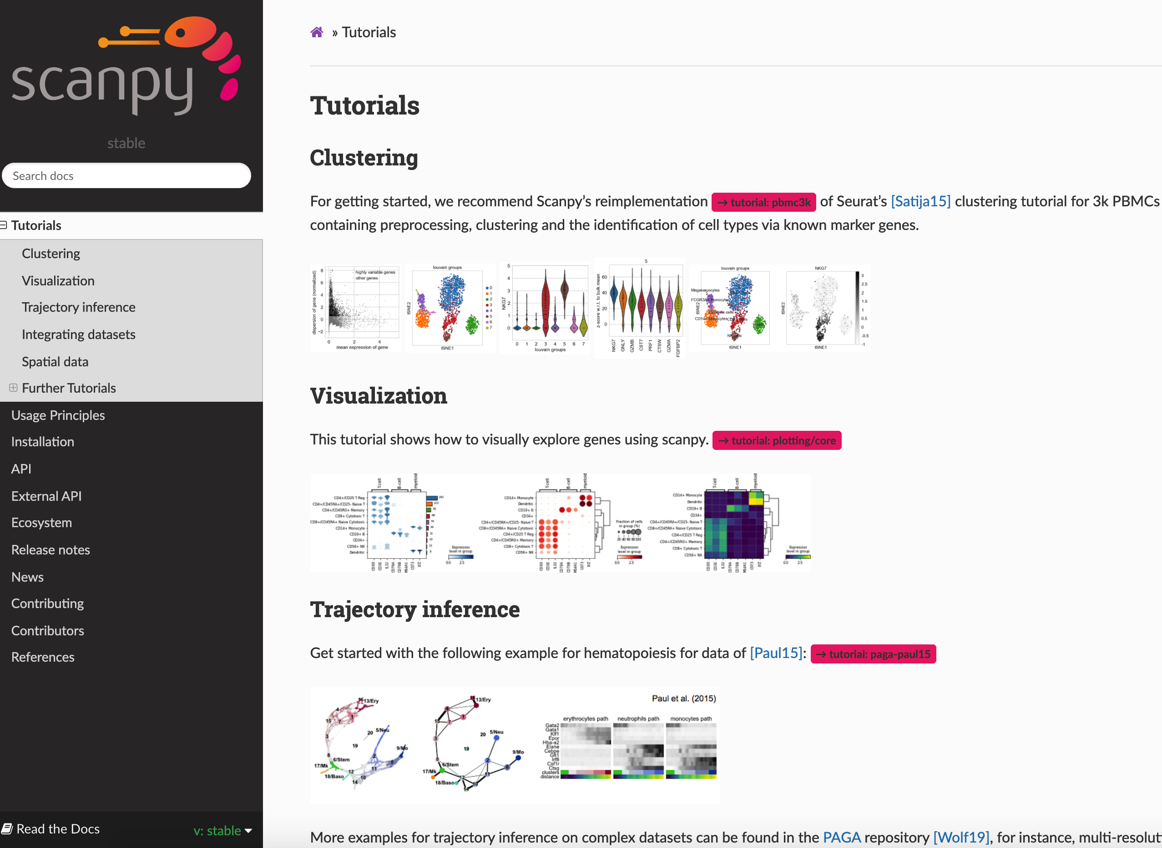
Same data set, similar analysis with Seurat.
But implemented in python.
Using jupyter notebook as a interface.
(.ipynb format can be converted to .RMD
to be run in Rstudio)

Slide 35
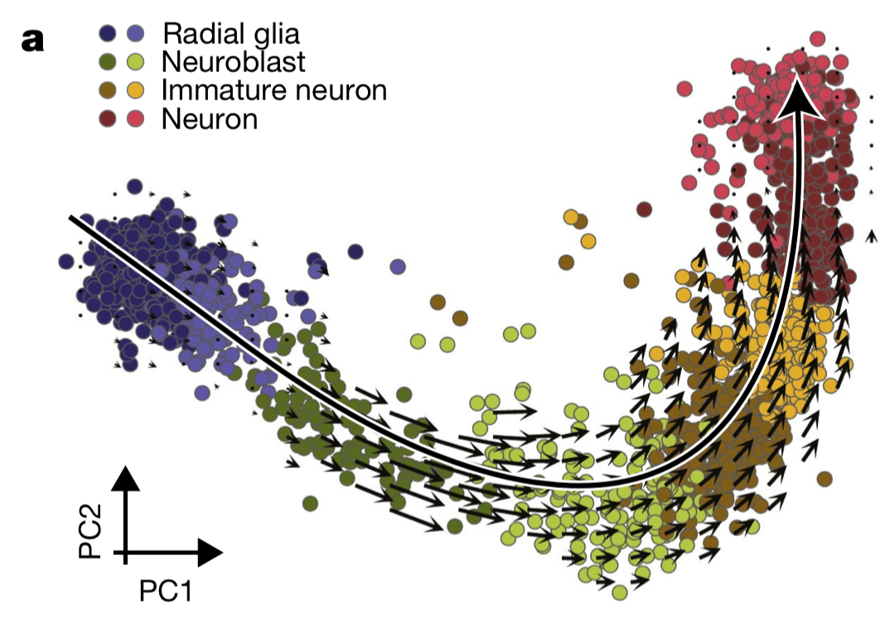
Trajectory analysis by RNA velocity
When cells differentiate, new genes will start to be expressed
Transcripts have introns and will be spliced off given time
Through assessing the present percentage of reads in introns, increase or decrease of expression can be modeled
https://liorpachter.wordpress.com/tag/velocyto/
http://pklab.med.harvard.edu/software.html

Slide 36
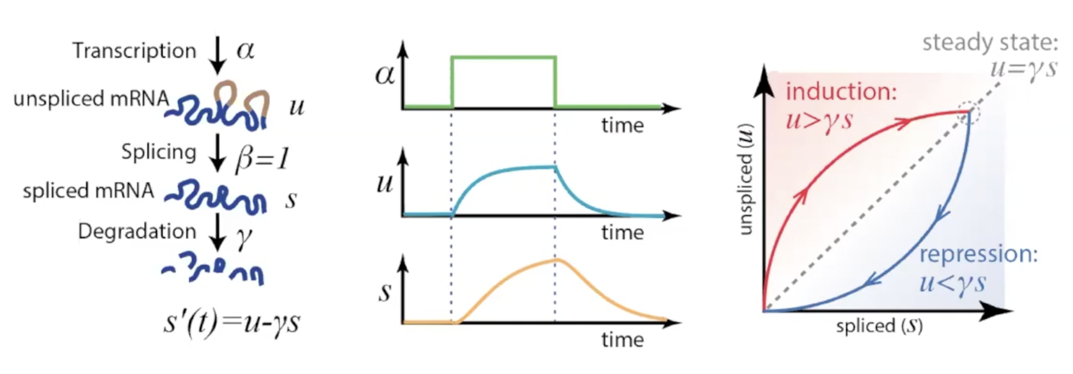
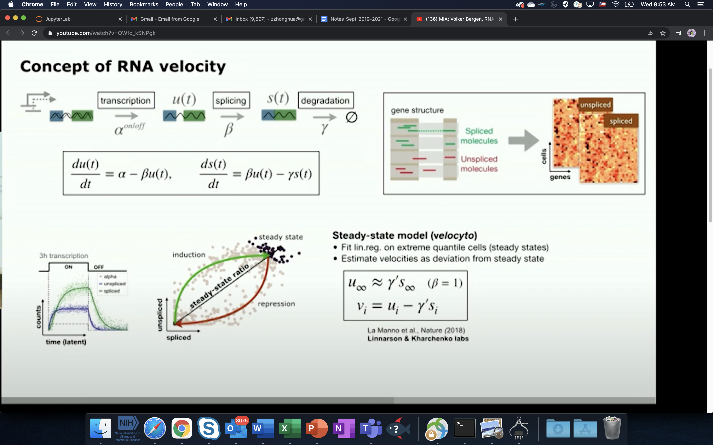
Modeling RNA dynamics
2 assumptions:
steady states has been observed
a constant splicing rate β across all RNA

Slide 37
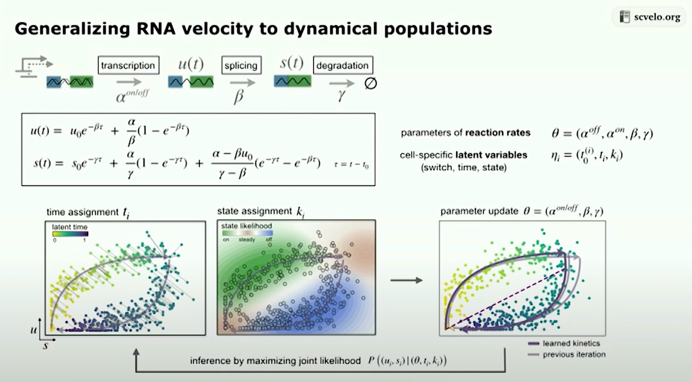

Slide 38
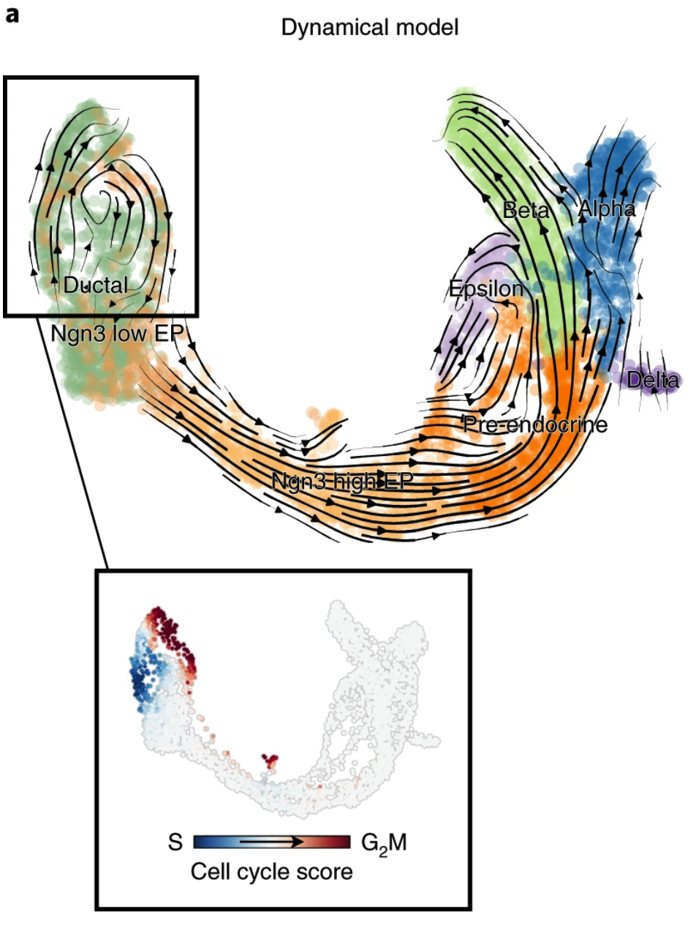
Steps of RNA-velocity
From cellranger produced bam files
Sort bam files
Using Velocyto CLI to identify exonal/intronal reads as loom files.
Use scVelo to model the data and recover RNA dynamics
Through Markov process to predict which neighbor is the most probabal destiny for he cell.
Backtracking and forward tracking to get the destiny and ancestor of the cell.
Nature, 2018. invented the concept
Nature Biotechnology, 2020. a generalized model

Slide 39
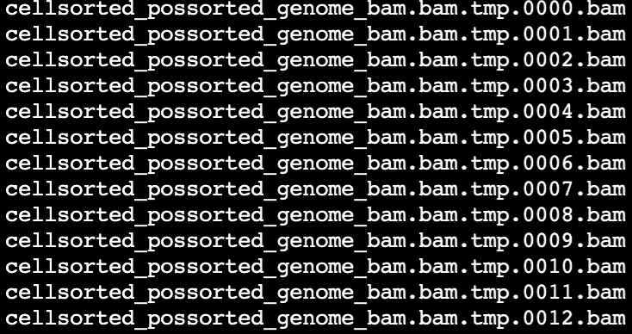
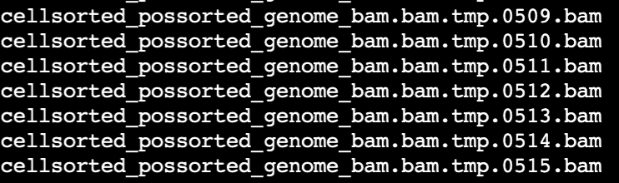
Get information about spliced/unspliced transcripts from bam files
#Build pipe line and shared scripts and instruction to researchers
https://github.com/zhuy16/single-cell-RNA-seq/tree/master/scvel_notebooks
Step 1, finding reads mapped to un-spliced regions.
#Sort BAM files with Barcodes
samtools sort -t CB -O BAM -o cellsorted_possorted_genome_bam.bam
possorted_genome_bam.bam​
#Analyze reads from spliced/non-spliced transcripts,
module load python/3.7.3-foss-2016b​
velocyto run10x cellranger_output_folder genes.gtf​

Slide 40
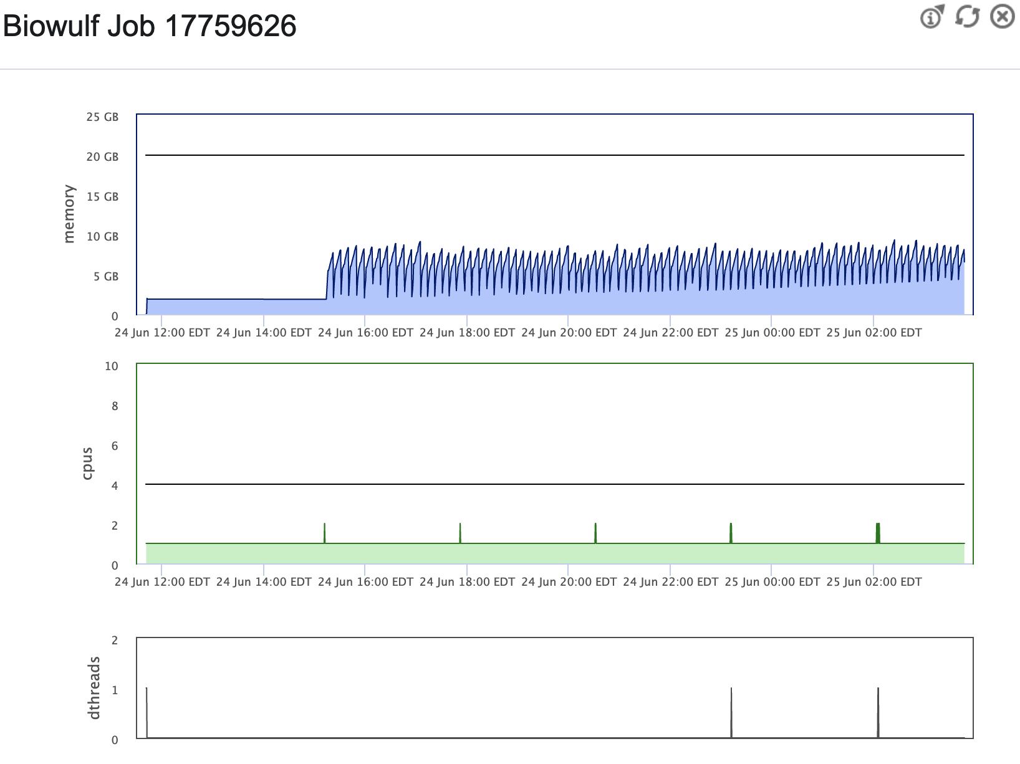
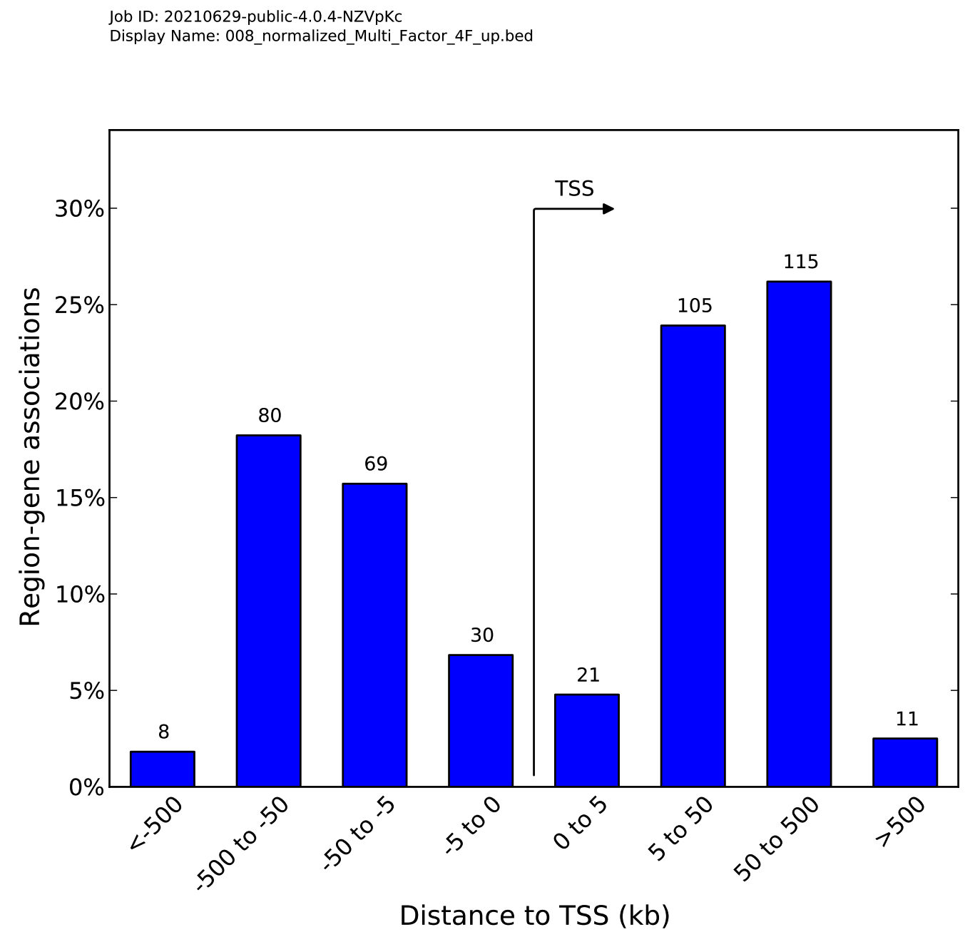
A example for velocyto CLI job – half a day

Slide 41
Demo on RNA velocity

Slide 42
Summary of day 1, scRNA-seq
Set up the working environment
Login and pseudolinks to data
Copy files to scratch drive
Evoke jupyter lab IDE
Introduction to scRNA-seq
Make fastq from bcl files
Use cellranger count to do alignment
Use Seurat/scanpy pipeline to do QC and dimension reduction
Use RNA velocity to infer trajectory
For tomorrow: please install IGV and IGB for visualization of alignment, on your local machine.

Slide 43
Reference
Make fastq and cellranger count
https://davetang.org/muse/2018/08/09/getting-started-with-cell-ranger/
Seurat pipeline on pbmc
https://satijalab.org/seurat/articles/pbmc3k_tutorial.html
Scanpy pipeline
https://scanpy-tutorials.readthedocs.io/en/latest/pbmc3k.html
RNA velocity
velocyto CLI
https://velocyto.org/velocyto.py/tutorial/cli.html
scVelo
Scvelo: https://scvelo.readthedocs.io/VelocityBasics/

